Slide 1
Feedback in DSP
Feedback workshop
LE Kristiansand
Øyvind Brandtsegg

Slide 2
DSP components
+ - * / and delay
Simplest digital lowpass filter:
  y(n) = (x(n) + x(n-1)) / 2
Input
“A digital filter is a computational process or algorithm by which a digital signal or sequence of numbers (acting as input) is transformed into a second sequence of numbers termed the output digital signal” (Rabiner et al. 1972)
Delay1
(* 0.5)

Slide 3
Butterworth IIR filter
2. order, Pole Zero filter
Digital implemention of a Butterworth filter
  Analog filter design from ca 1930
  Objective: flat response in passband
Audio
Delay1
* (-b1)
Delay1
* (-b2)
* a0
Delay1
* a1
Delay1
* a2

Slide 4
Flanger
Variable delay line, 1-15 ms
  Feedback (!) ksmps=1
  We can delay the clean signal to make a ”thru zero flanger”
LFO
x
+
Time
+ offset
*-1
Inverted phase
(more «lush»?)
Delay
+
+
(ThruZero Offset Delay)

Slide 5
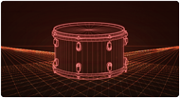
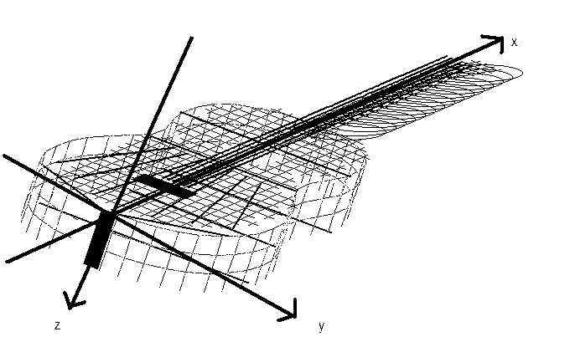

Physical model of instrument
Excitation
  Plectrum/pick on guitar
  Stick hit on drum
  Vocal cords for singer
  Mouthpiece for wind instrument
Resonator
  Can be implemented as a waveguide
  Resonator = Filter = Waveguide
  Here: model of how sound waves travel in an object

Slide 6
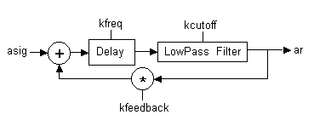
Simplest form
Vibrations in a string (Karplus Strong)
http://www.csounds.com/manual/html/wguide1.html
audio input
audio output
x(n)
y(n)
+
Delay
Delay

Slide 7

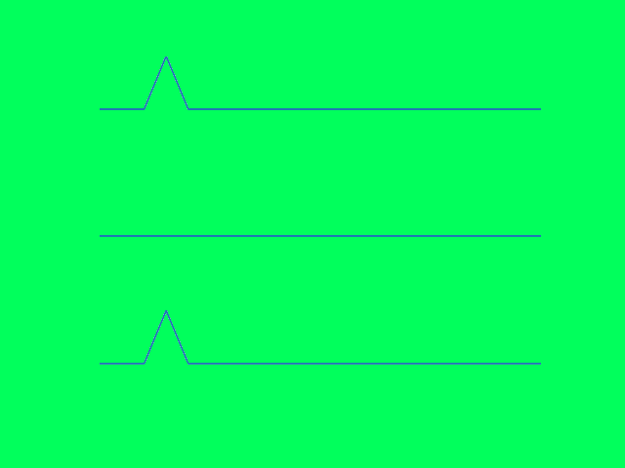
String model (waveguide)
audio input
audio output
x(n)
y(n)
+
Delay
Delay
a
b
a+b
=

Slide 8
Allpass filter as reverberator
Allpass filter lets all frequencies through,
ideally it has a flat frequency response
*(-g)
+
Dly (M₁)
+
g = coefficient (gain)
M = delay time
*g
Manfred Schroeder: cascade of allpass filters, series
*(-g1)
*(-g2)
*(-g3)
+
Dly (M₁)
+
+
Dly (M₂)
+
+
Dly (M₃)
+
*g1
*g2
*g3
Typical values:
g = 0.7
M = prime number (in number of samples), e.g. M₁=1051, M₂=337, M₃=113
https://primes.utm.edu/lists/small/1000.txt

Slide 9
Parallel, series, nested
Series
Filter
Filter
Filter
Filter
Parallel
Filter
+
Filter
Nested
”Filter in filter”
*(-g1)
*(-g2)
+
Dly (M₁)
+
Dly (M₂)
+
+
*g2
*g1

Slide 10
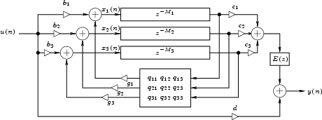
FDN: Feedback Delay Network
First suggested by M.A. Gerzon, article i ”Studio Sound” 1971, later refined by J.O.Smith (ICMC 1985) and others
Similar to waveguides
Small random variations in delay time (pitch modulation)

Slide 11
FDN Reverb Csound (screverb)
*(2/N)
M = delay time
in num samples (prime numbers)
M modulated with random deviations,
i.e. noise with low amplitude and low frequency
g = gain (= reverb time)
Cutoff frequency for lowpass filter reduce the reverb time for higher frequencies (HF damp)
Cutoff frequency for the highpass filter remove rumbling in low frequencies (LF rolloff)
By using separate audio outs for each delay line, one can create a multichannel ”surround” reverb
-
Dly (M₁)
*g
Lowpass
-
Dly (M₂)
*g
Lowpass
-
Dly (M₃)
*g
Lowpass
+
+
Hipass
-
Dly (M₄)
*g
Lowpass
-
Dly (M₅)
*g
Lowpass
-
Dly (M₆)
*g
Lowpass
-
Dly (M₇)
*g
Lowpass
-
Dly (M₈)
*g
Lowpass

Slide 12
More from Sean Costello
(a treasure trove for reverb design knowledge)
http://valhalladsp.wordpress.com/
  E.g. «naming reverb algorithms»
  Pitch modulation in reverb
    http://www.youtube.com/watch?v=iNin4yAEx5o
  http://valhalladsp.wordpress.com/2009/05/30/schroeder-reverbs-the-forgotten-algorithm/

Slide 13
Waveguide mesh
Jon Christopher Nelson
https://csound.com/icsc2019/proceedings/12.pdf
https://jonchristophernelson.com/csound-software-downloads/

Slide 14
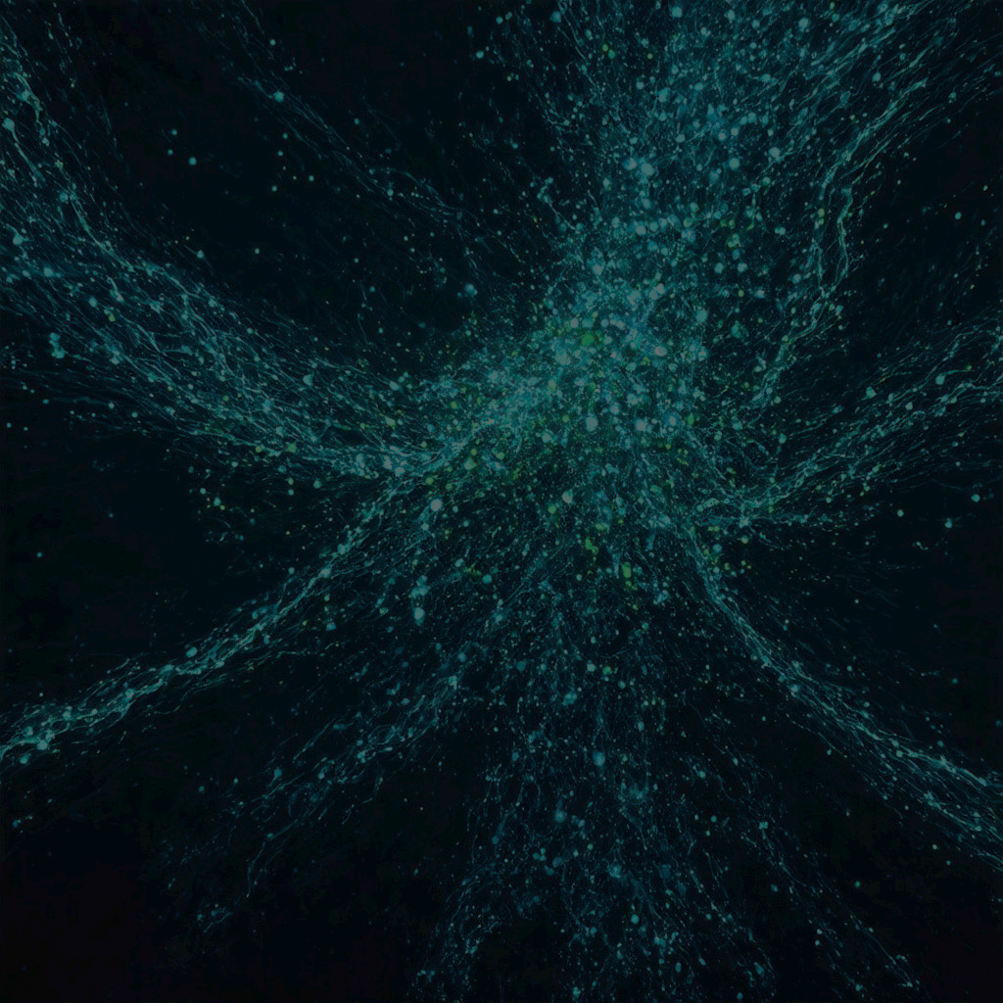
Frequency Modulation with Feedback in Granular Synthesis
Øyvind Brandtsegg – Norwegian University of Science and Technology
Victor Lazzarini – Maynooth University

Slide 15
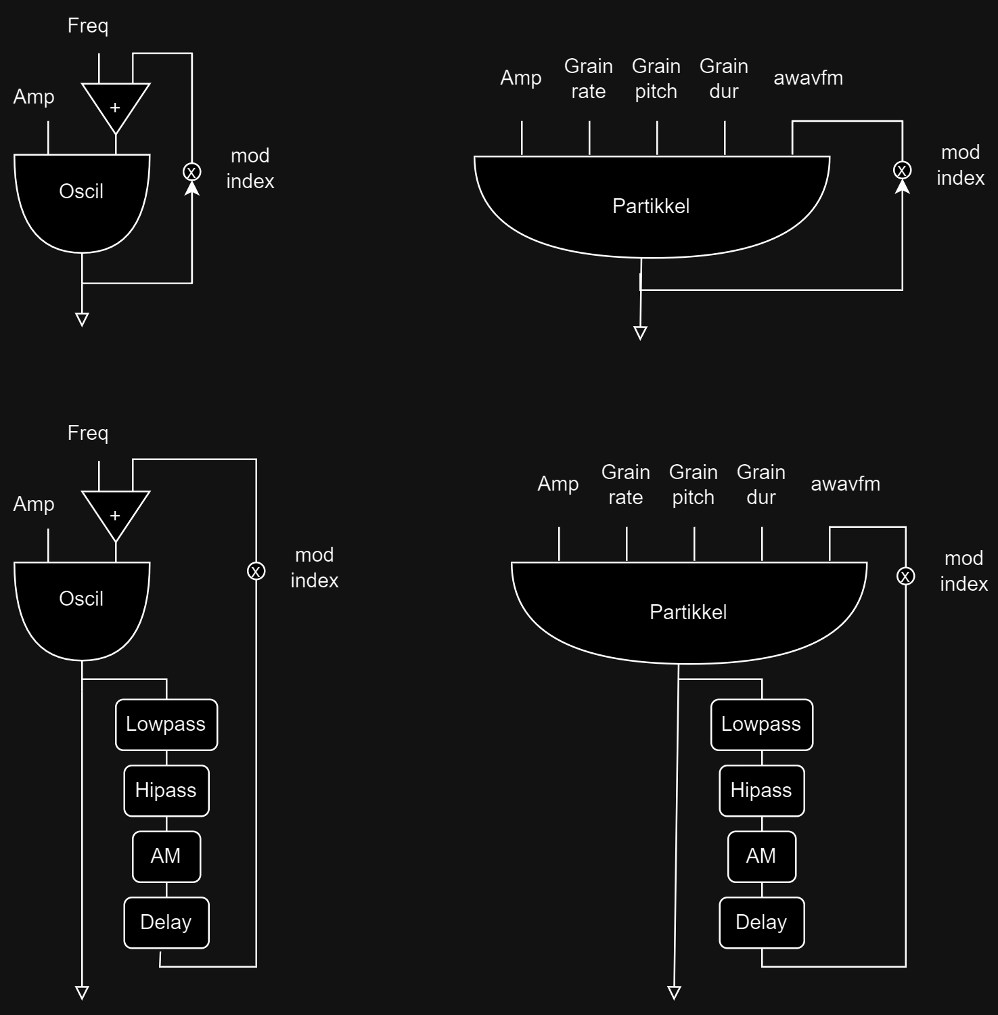
Why?
Interesting chaotic behavior in FM feedback
FM oscillator with feedback

Slide 16
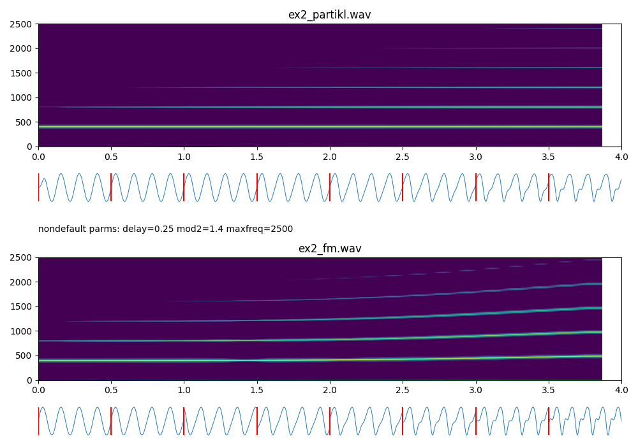
Problem
Pitch instability
Can be solved with PM,
…but also misses the interesting chaotic artifacts
AM in the feedback path (Lazzarini and Timoney 2023)
  Corrects the FM formula, making it akin to PM
Still:
  Feedback > 1.0 can not be defined analytically by an FM/PM espression
Granular synthesis is a kind of AM, and has additional parametric flexibility
  so can we use that?

Slide 17
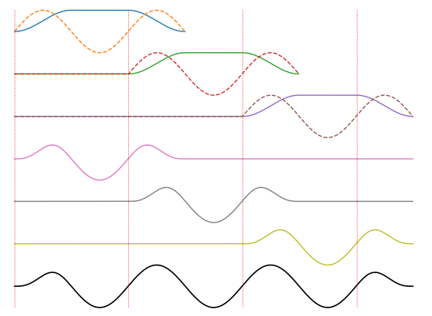
Signal flow
Oscillator model
Granular model
Equal power crossfading envelope on each overlapping grain: To recreate pure sine wave with granular synthesis

Slide 18
Adding some balancing processes in the feedback path
Oscillator model
Granular model

Slide 19
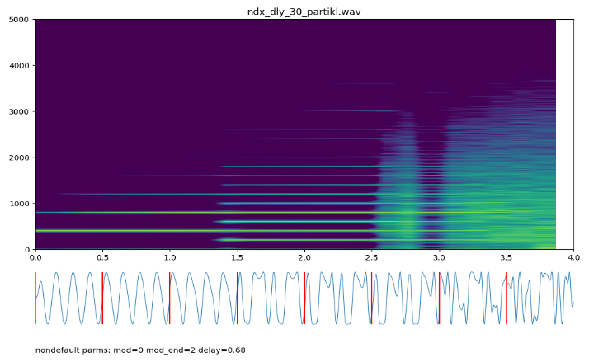
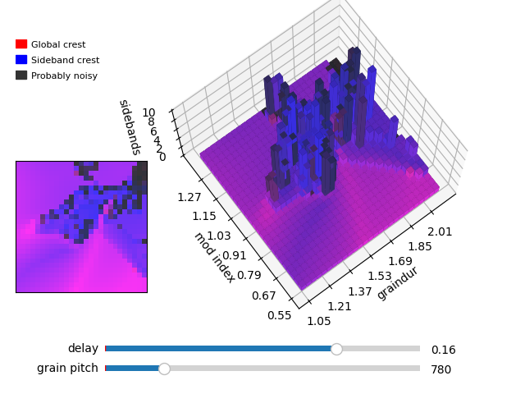
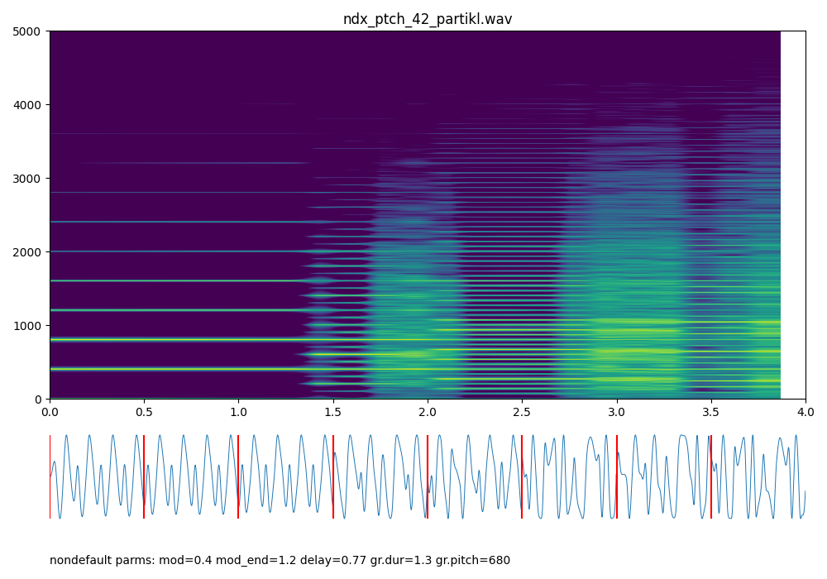
Tentative insights with more radical granular parameter settings
… its difficult but interesting …
Linear change of mod index
Exhaustive parameter combinations mapping
Linear change of mod index, high grain pitch

Slide 20
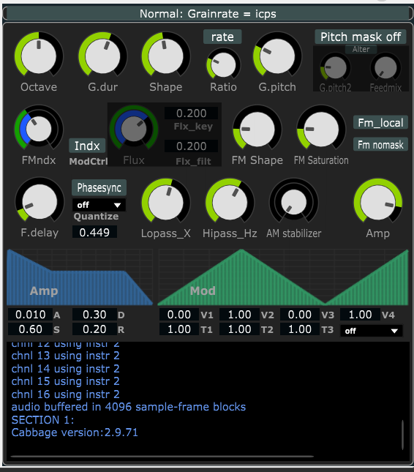
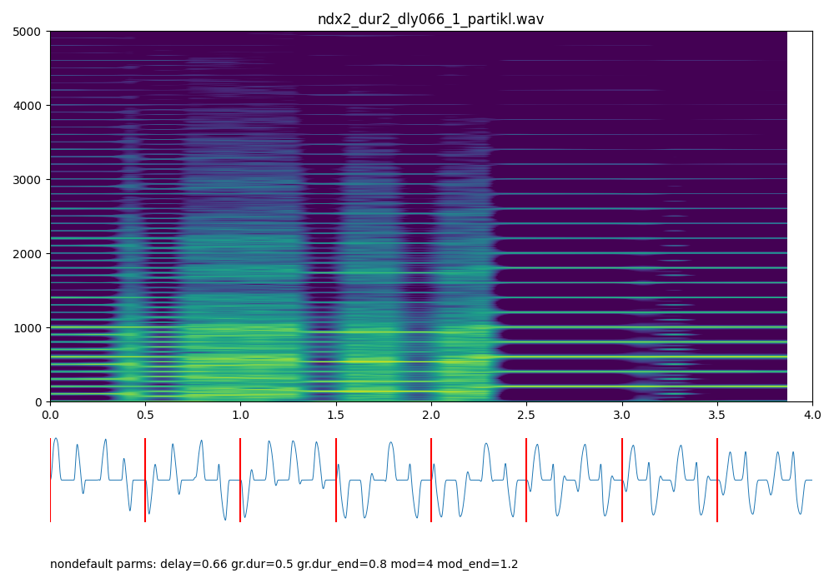
Test tools in git
https://github.com/Oeyvind/partikkel_fm
python generate_and_compare.py filename cps=200 gr.rate=200

Slide 21
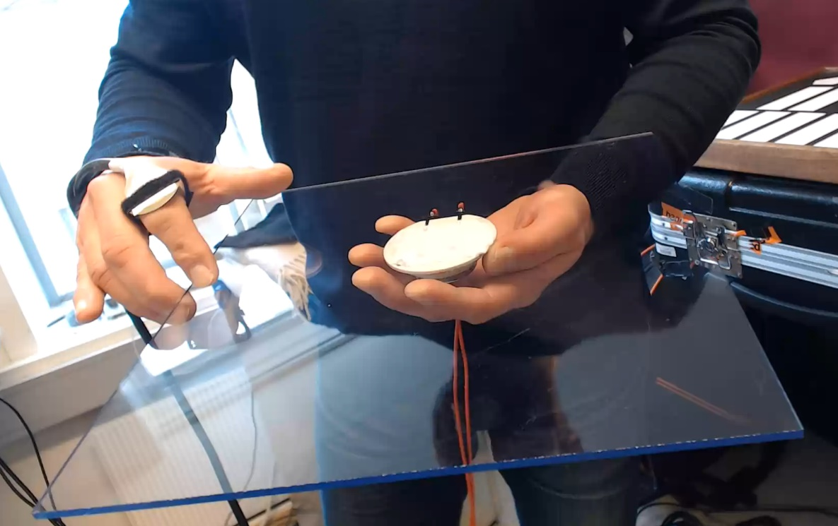
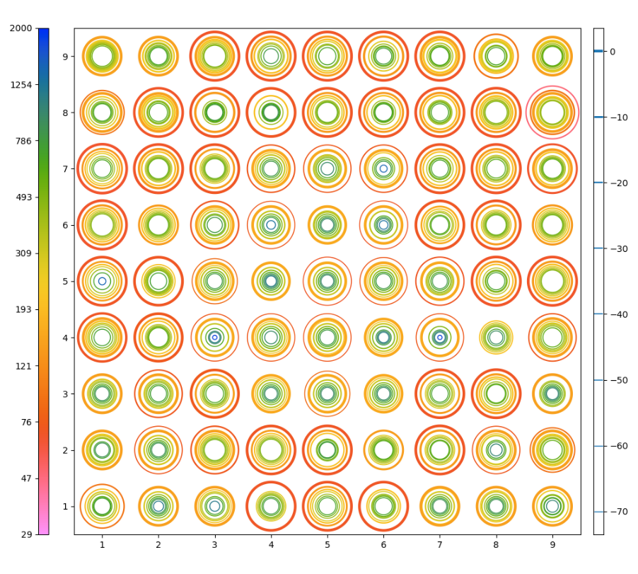
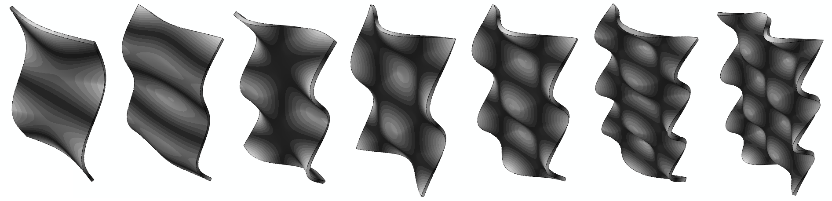
Feedback plate instrument

Slide 22
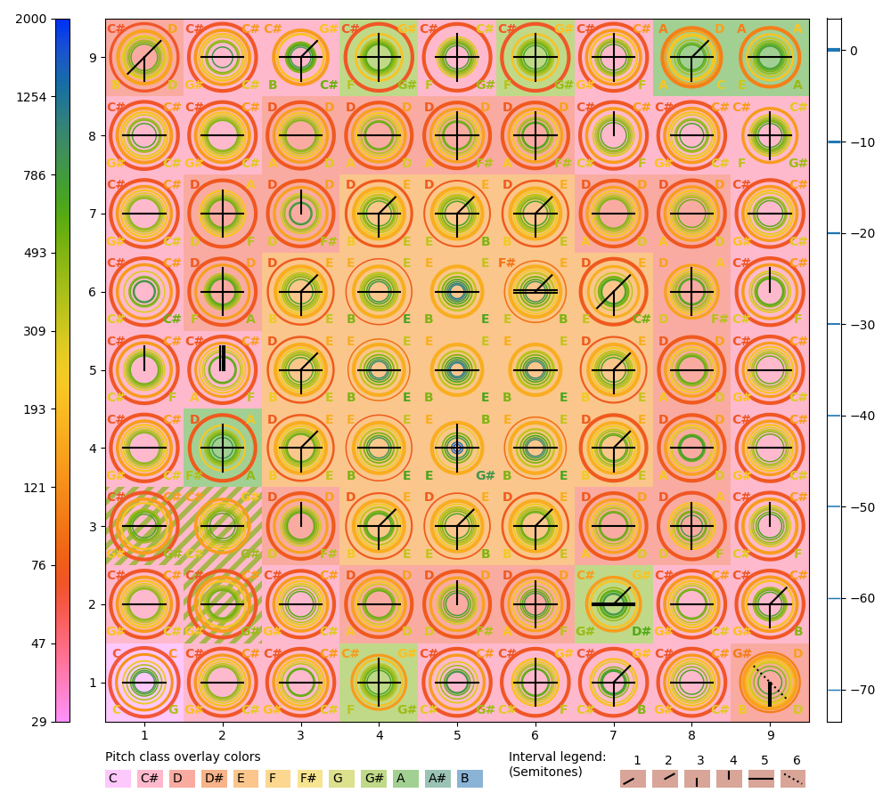
Feedback plate instrument

Slide 23
