Slide 1
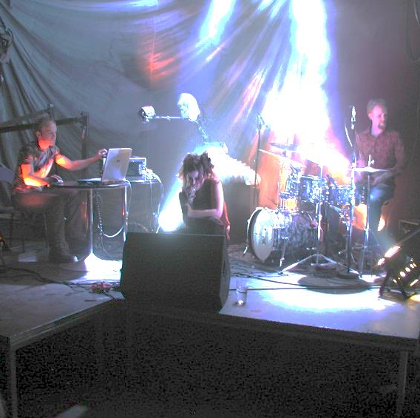
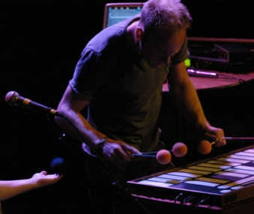
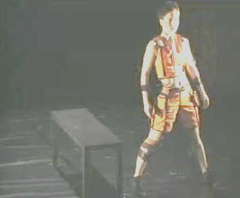
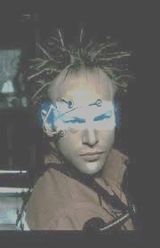
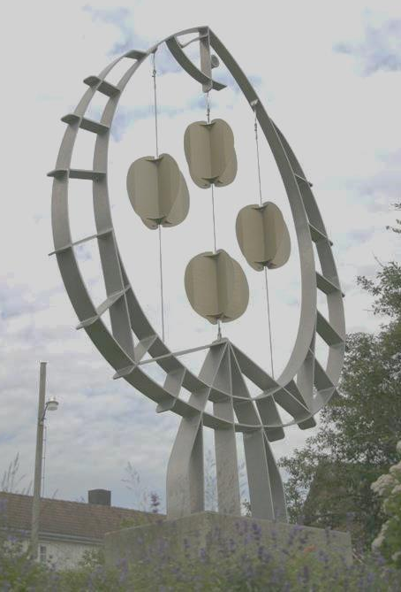
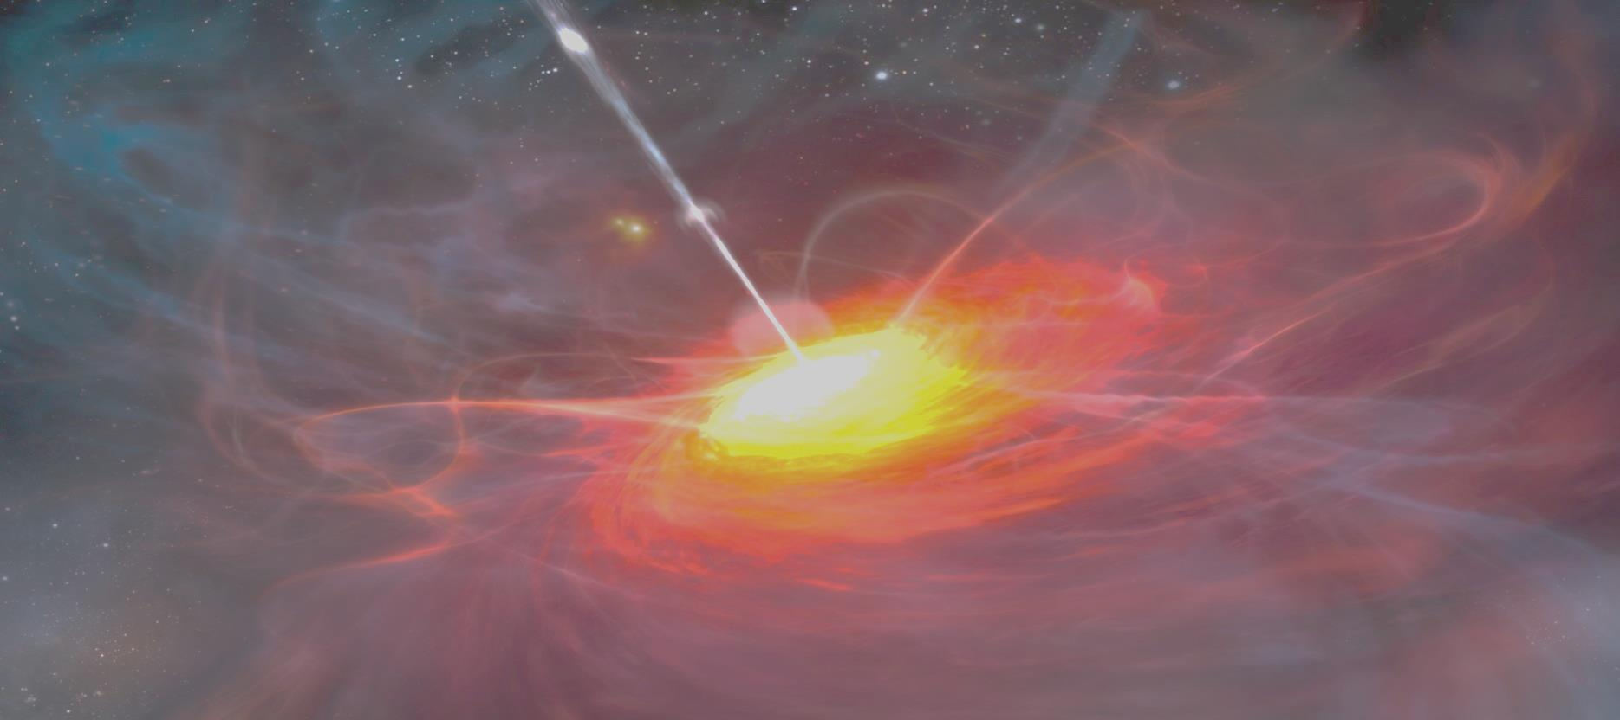
Playful new instruments
New applications of old technology
Sound art installations as instruments
Large instruments: Bridges
Environmental issues, recycling
Feedback
Pitch map of feedback instruments
Design challenges

Slide 2
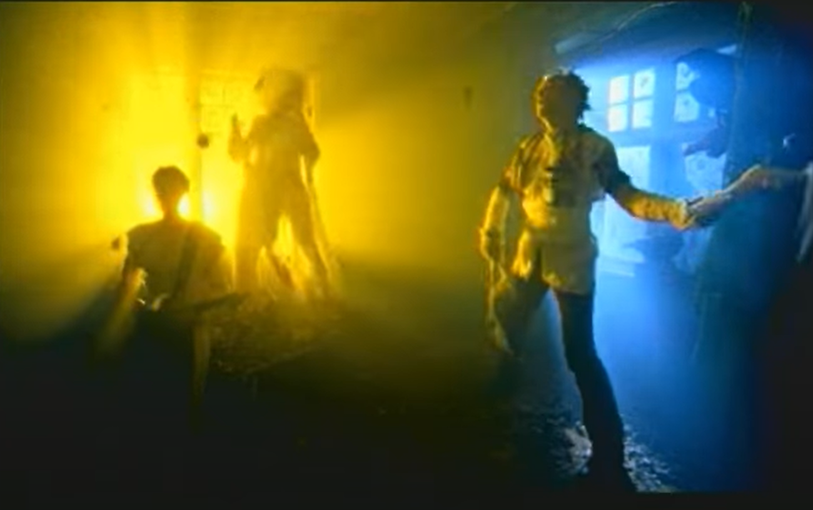
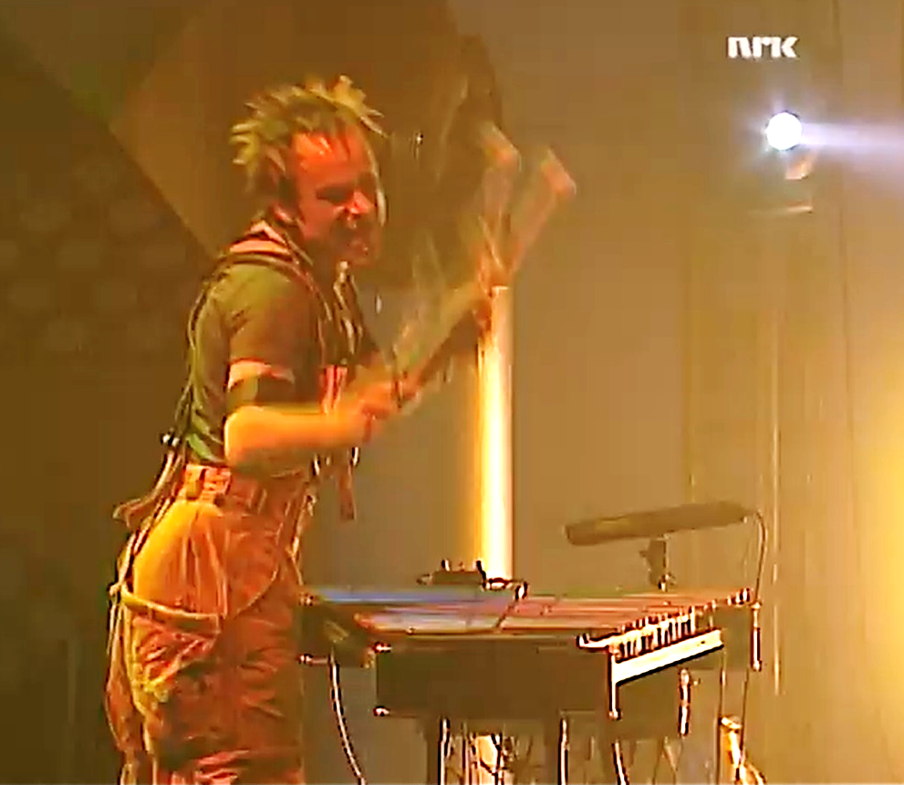
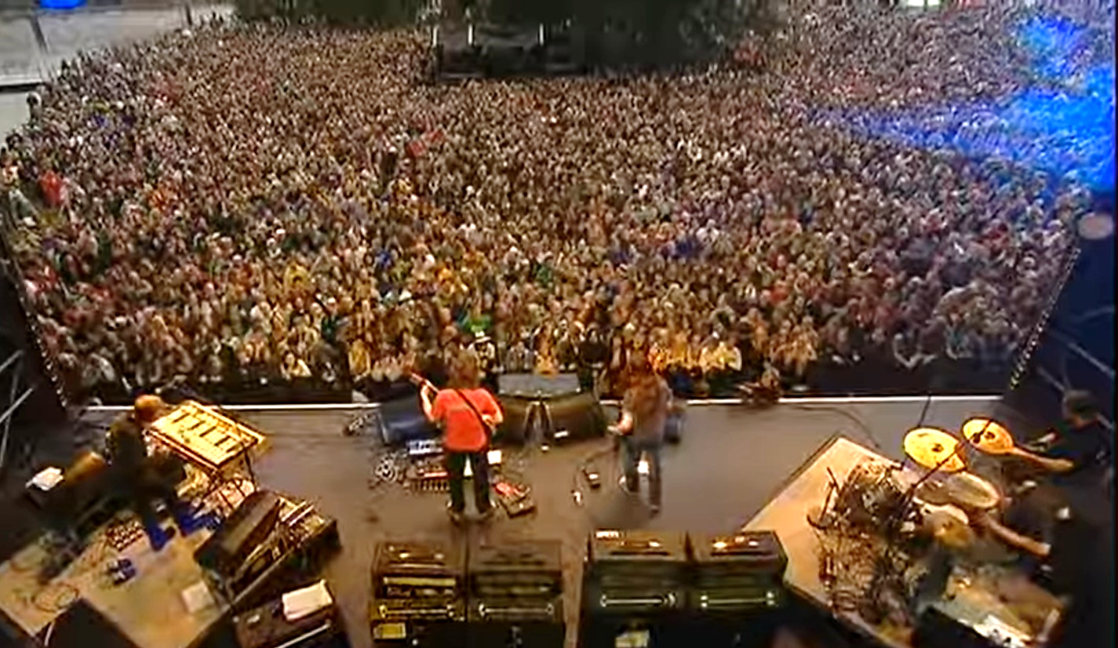
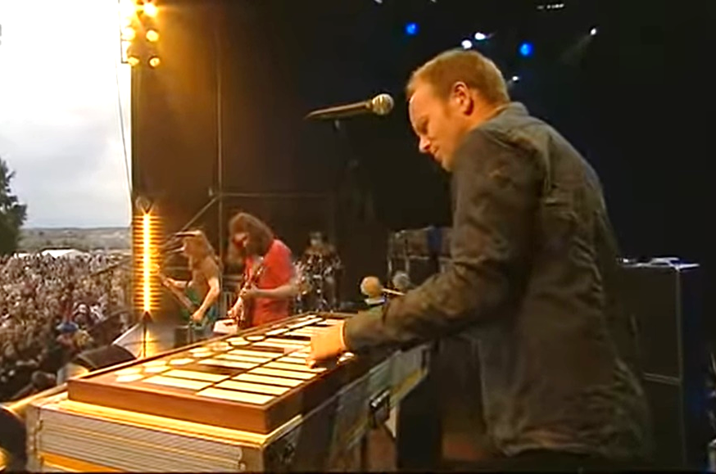

Slide 3
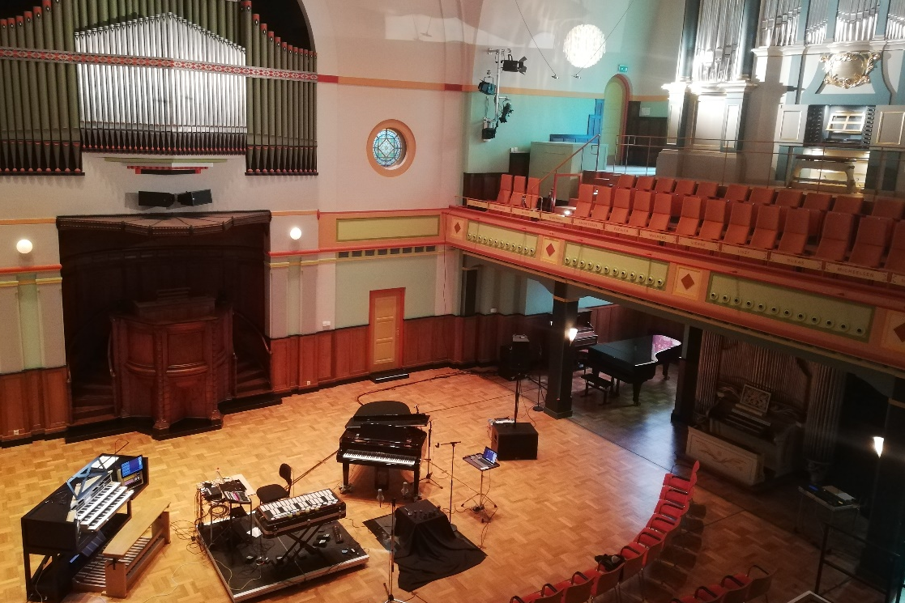
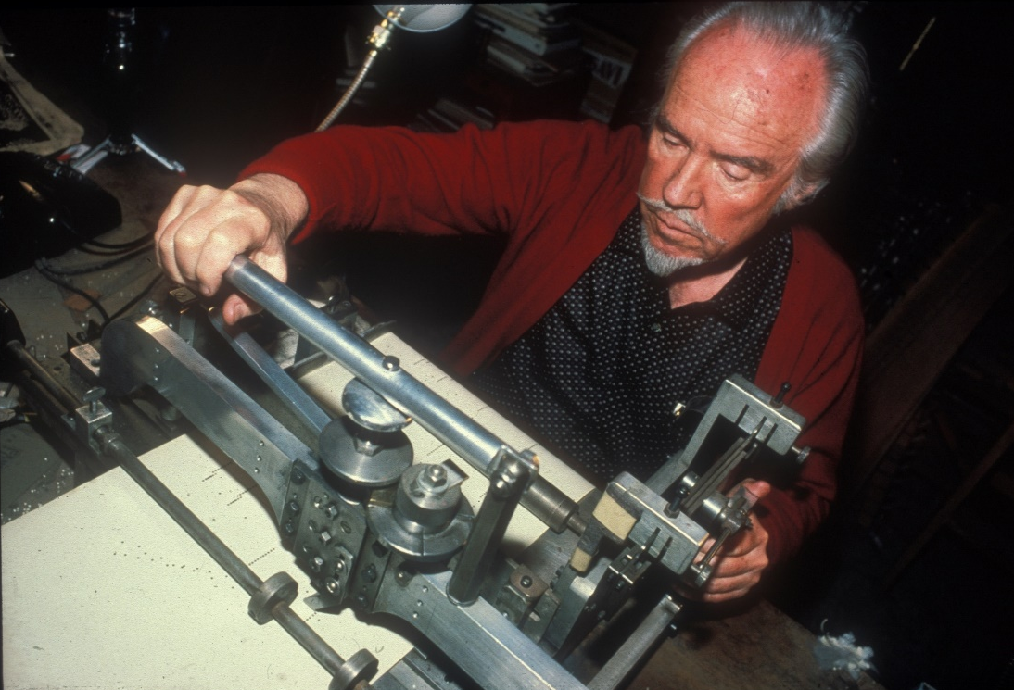
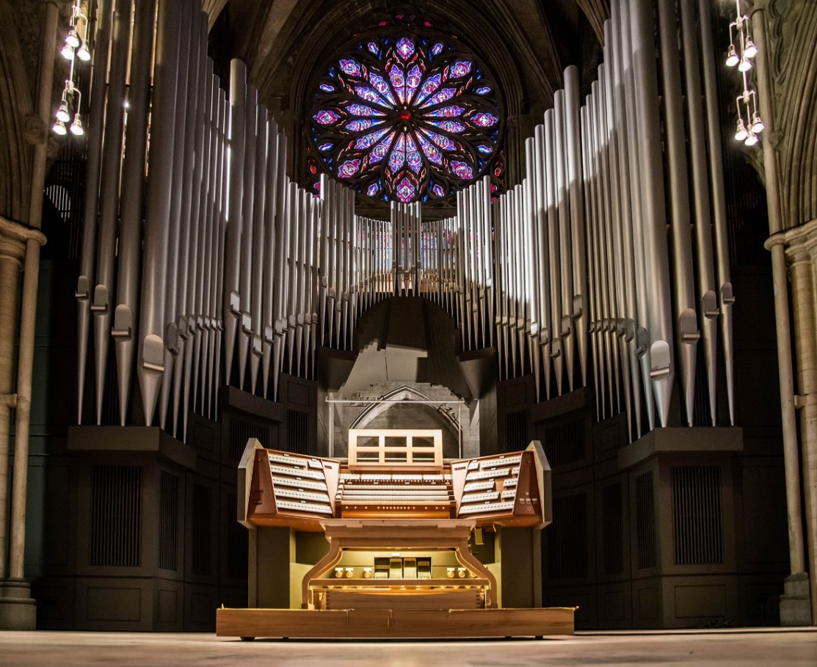
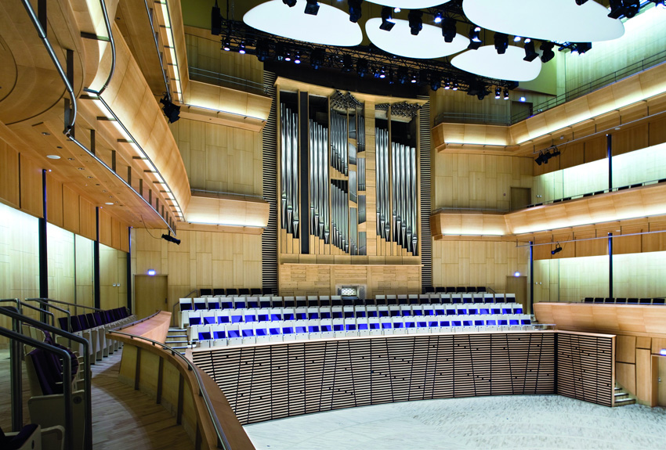
New applications, old technology
https://vimeo.com/463046453

Slide 4
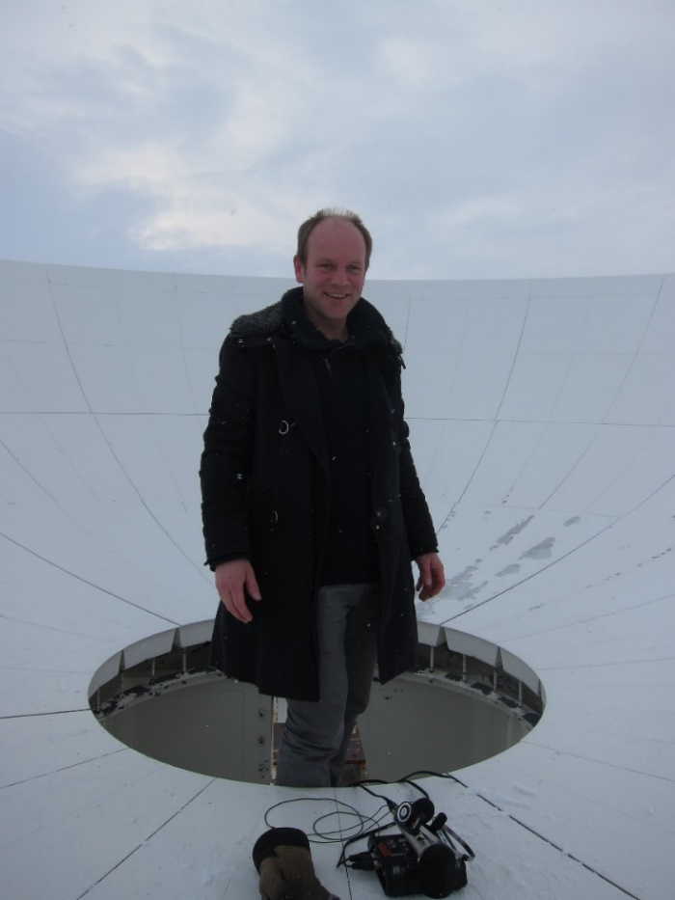
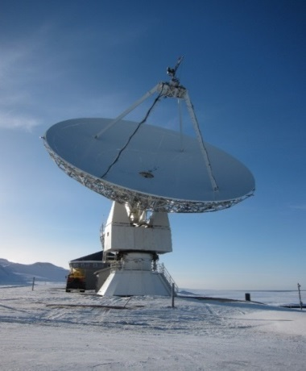
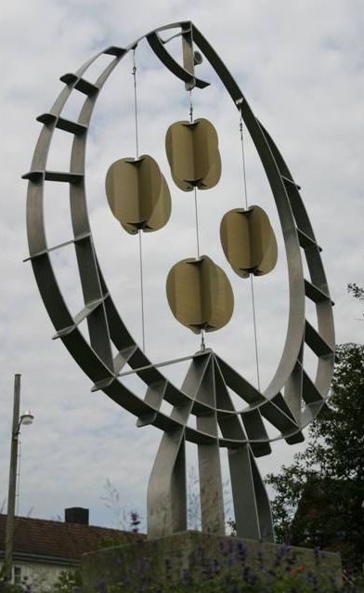
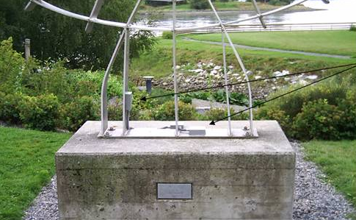
Sound art installations as musical instruments
Notes:
Svalbard, experience the antenna and environment

Slide 5
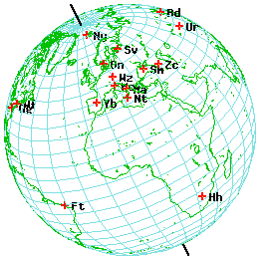
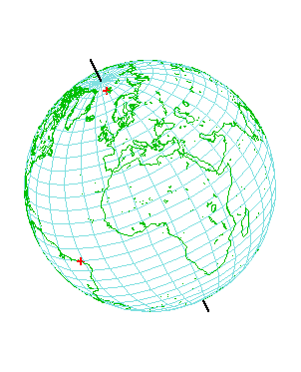
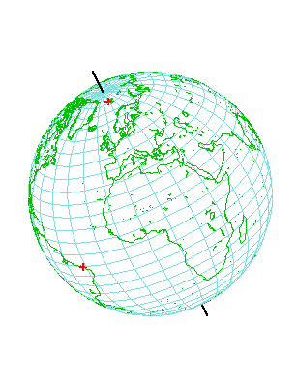
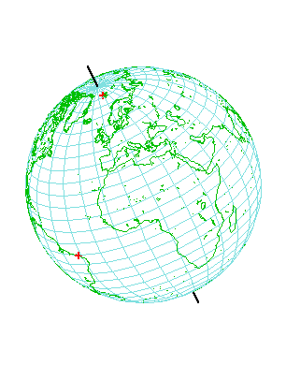
VLBI: Global choreography
Notes:
Global coreography of the antennas

Slide 6
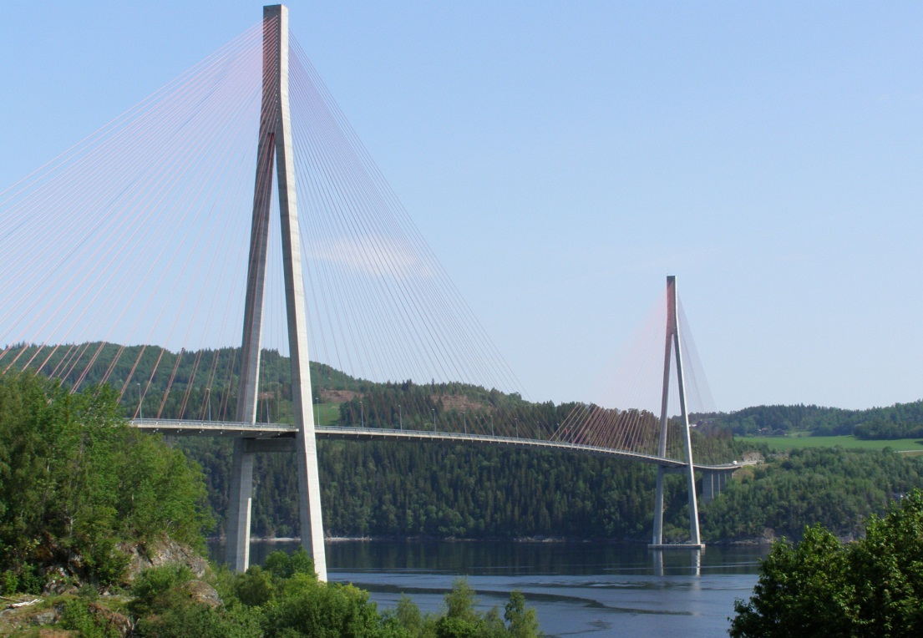
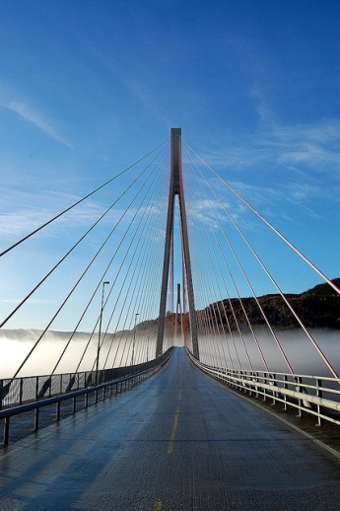
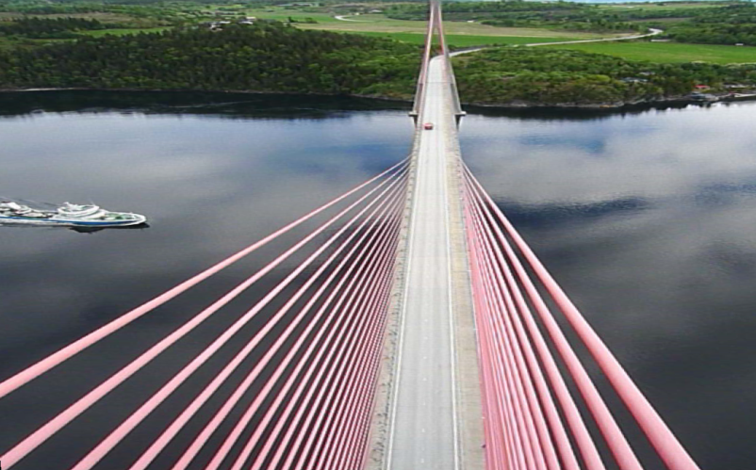
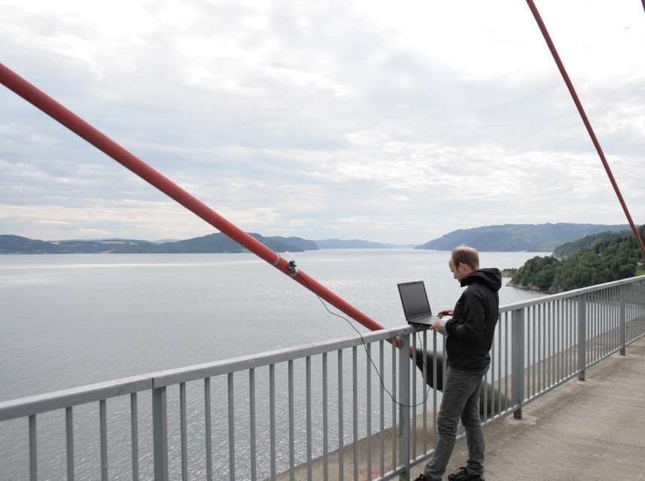
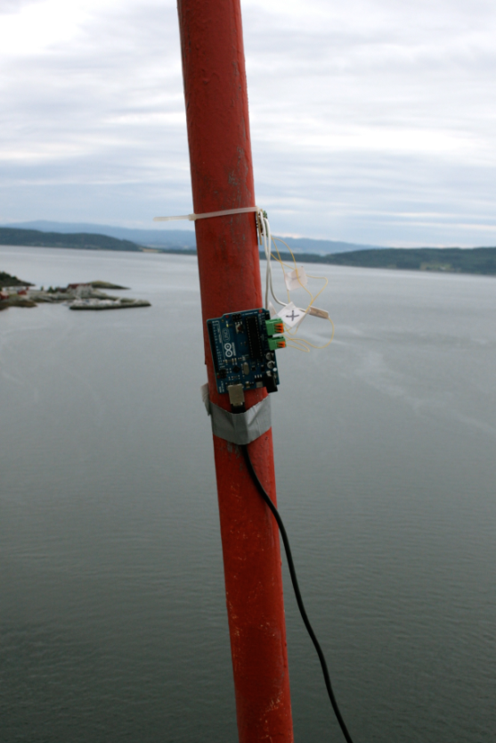
Skarnsundbrua

Slide 7
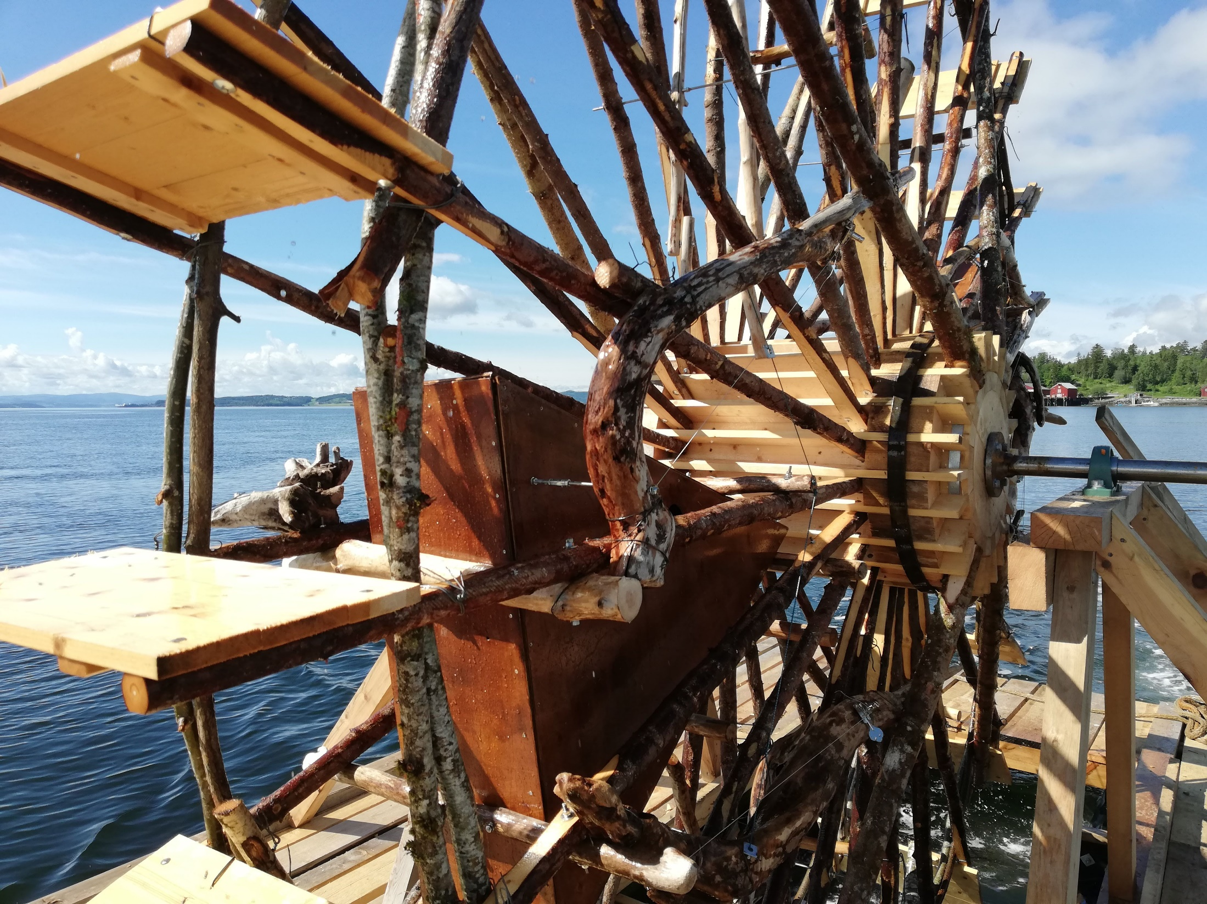
Environment, Recycling, Energy
https://www.youtube.com/watch?v=1gAPn_e_cE0

Slide 8
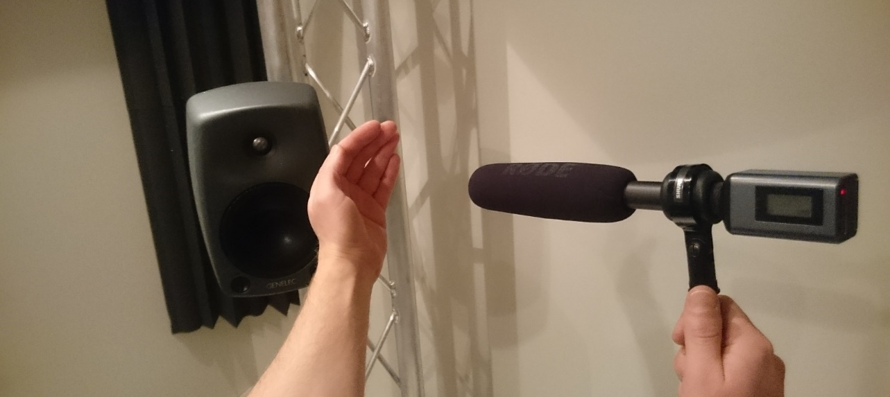
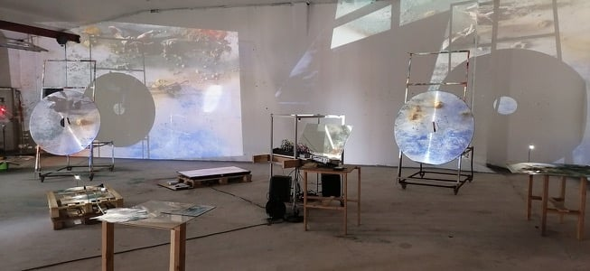
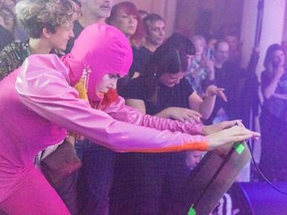
Recycling - Feedback

Slide 9
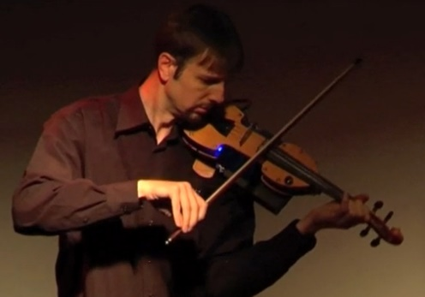
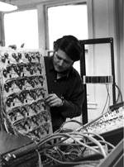
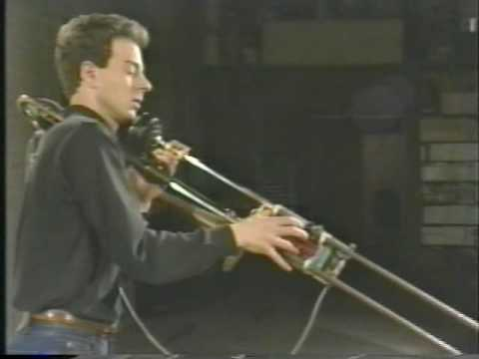
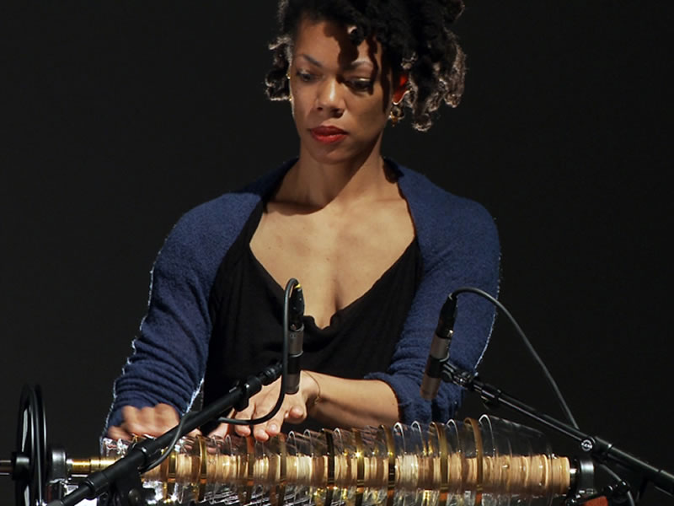
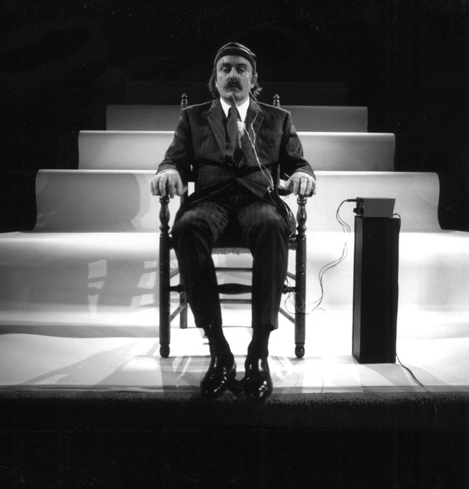
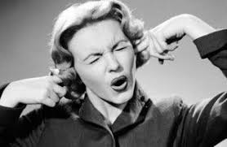
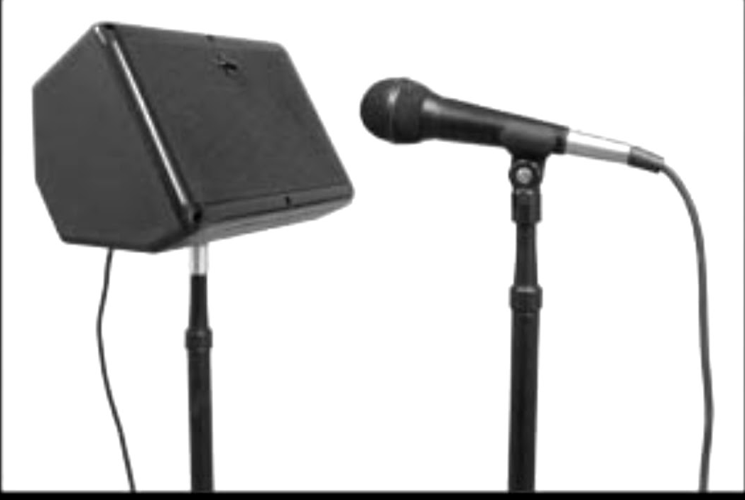
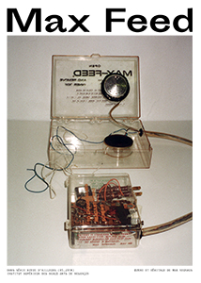
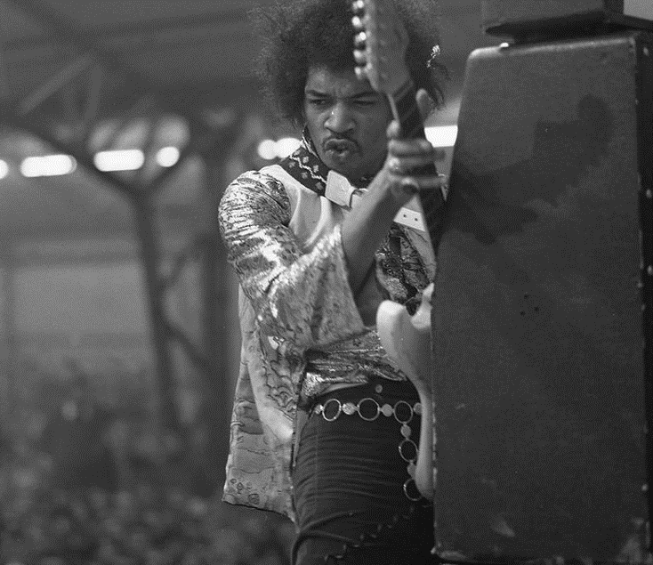
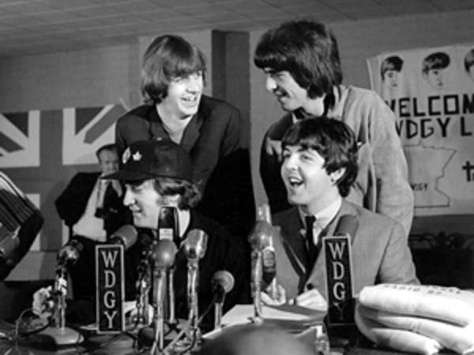
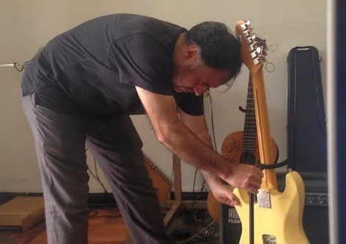
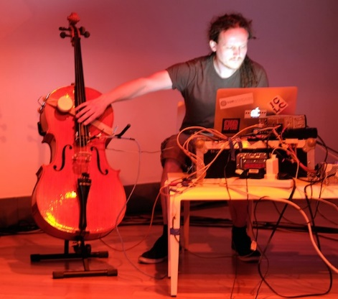
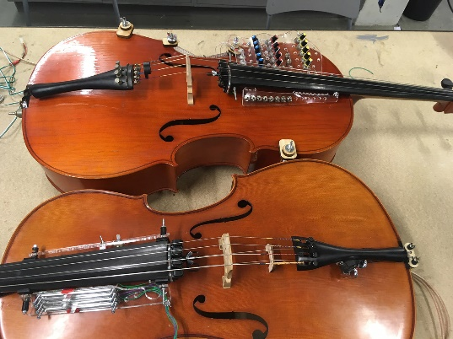
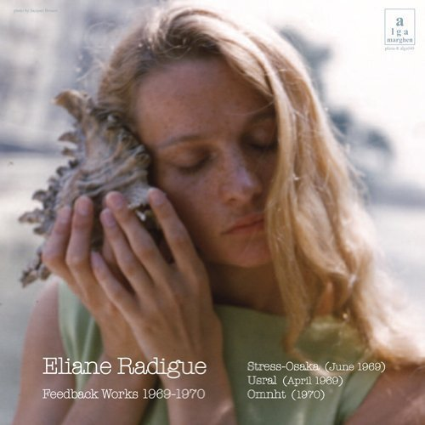
Feedback
Musikk lever i spennet mellom poesi og katastrofe
Music exist in the space between poetry and catastrophe
Arne Nordheim

Slide 10
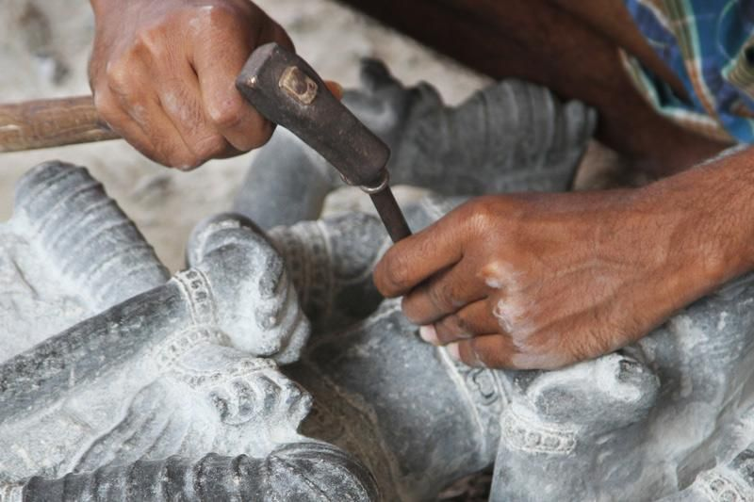
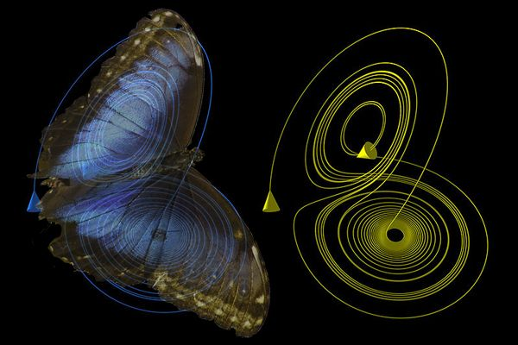
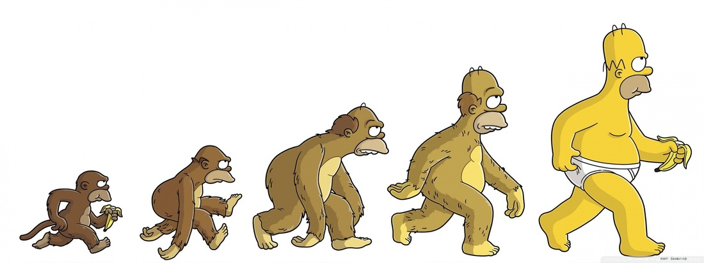
Feedback - properties

Slide 11
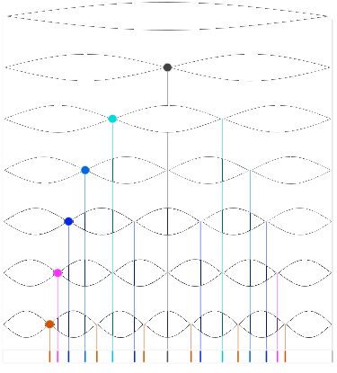
Scientific <-> Artistic

Slide 12
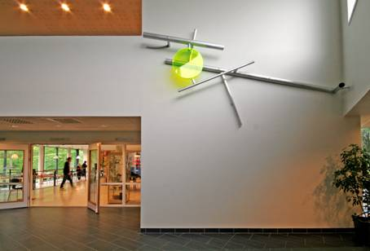
Bone conduction feedback (2018)
Feedback sculptures: collaboration with Viel Bjerkeset Andersen 2007
Exploration of room modes (Nodalings style) with shotgun mic (2012)

Slide 13
Shotgun mic piece

Slide 14
Tools, signal chain
Compressor
Generous application: Low thresh, high ratio
EQ
Equalize, even out frequency response so we have more different feedback potentials
Reverb, delay
why?

Slide 15
Compressor adjustment (start safe)
Connect mic
Set the threshold to just above the noise floor
Set ratio 4:1
Connect speaker
Adjust to taste

Slide 16
Frequency response test
Measure frequency response, maybe your EQ shows it?
Adjust EQ to balance out the strongest and most obvious resonances

Slide 17
Equalizer adjustment
For one specific situation and mic placement?
More general approach?

Slide 18
Contribution from phase
Microphone here? … or here

Slide 19
Adaptive feedback control search for resonances (peaks) and filter them out

Slide 20
Other effects in the feedback path
Pitch shift:
accumulate pitch shift for each feedback round
Frequency shift
Small frequency shift can help *avoid* feedback
Ring modulation
Create sidebands, but suppress the input frequencies
Granular delay
Fluttering and disjointed addition/coloring

Slide 21
Feedback plate instrument

Slide 22
Feedback plate instrument

Slide 23
Process, over time

