Slide 1
Distortion
Ear training for digital audio production
Øyvind Brandtsegg

Slide 2
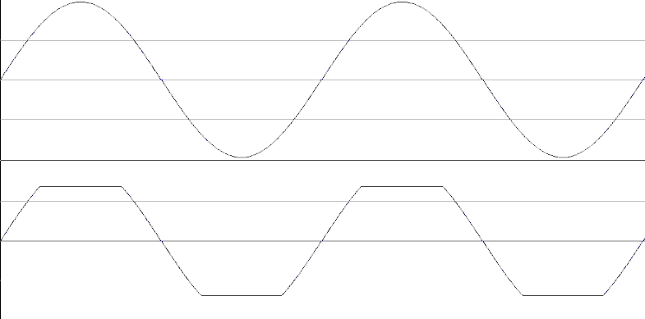
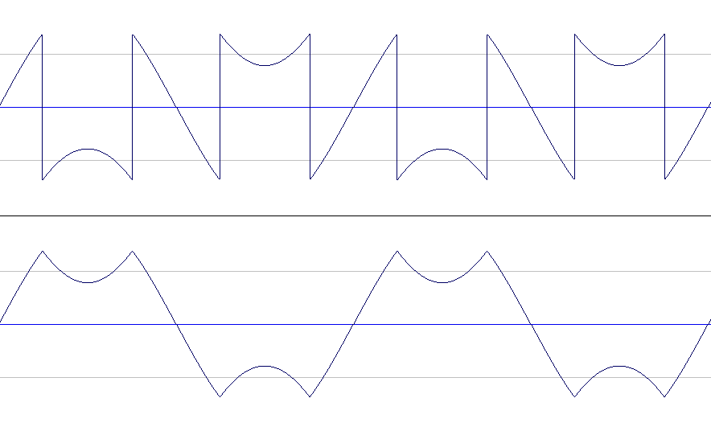
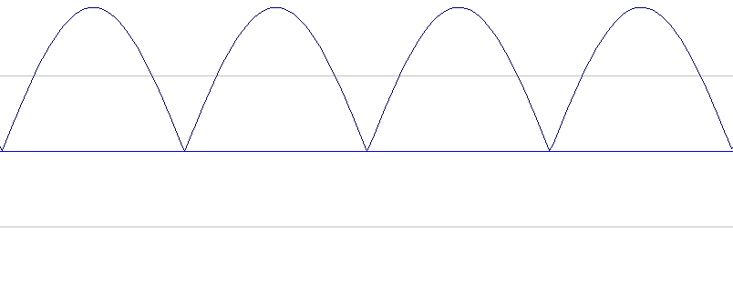
Clip, wrap, mirror
Clean sine
Hard clip
Wrap
Mirror
Rectifier

Slide 3
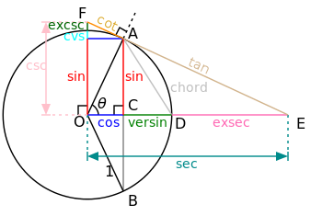
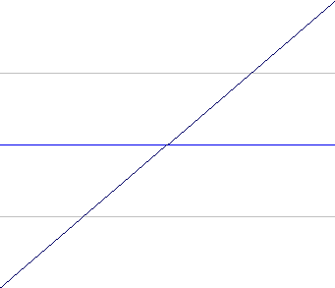
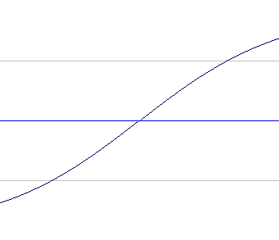
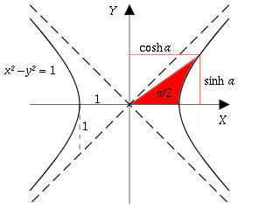
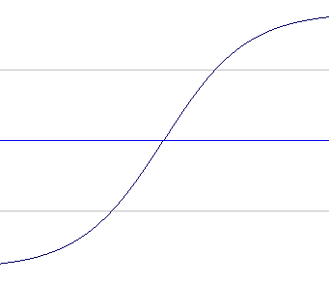
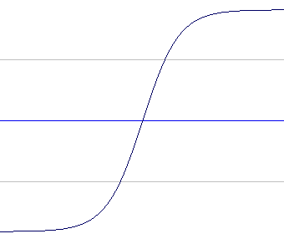
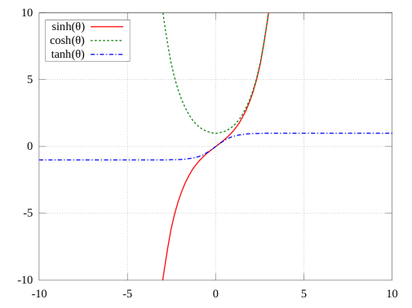
tanh, hyperbolic tangent
x = line -1 to 1
tanh(x*1)
tanh(x*2)
tanh(x*4)

Slide 4
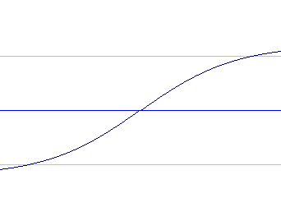
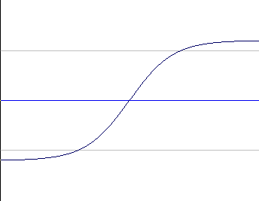
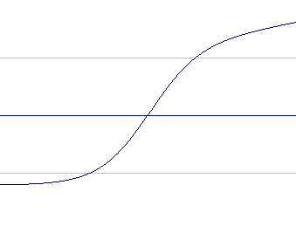
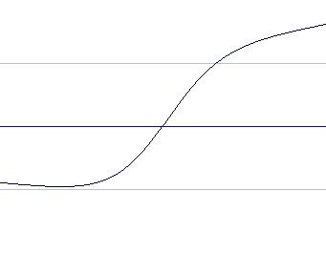
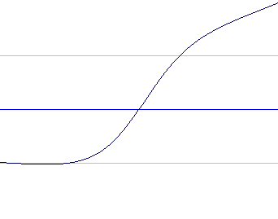
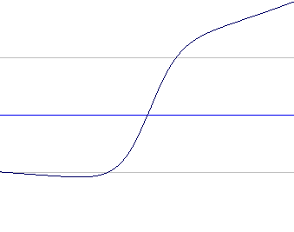
Modified tanh
http://csoundjournal.com/ezine/winter1999/processing/index.html og https://csound.com/docs/manual/distort1.html
asig = aLine
kshape1 = 0 ; a
kshape2 = 0 ; b
kpreG = 1.5 ; G
kpostG = 1.5
amod = (exp(asig * (kshape1 + kpreG)) - exp(asig * (kshape2 - kpreG))) / (exp(asig * kpreG) + exp(-asig * kpreG))
amod = amod * kpostG
exp(x*(a+G)) – exp(x*(b-G))
exp(x*G) + exp(-x*G)
The term exp(x) means the same as ℮^{x}
℮ = 2.718281….
G = 1.5, a = 0, b = 0
G = 3, a = 0, b = 0
G = 3, a = 0.3, b = 0
G = 3, a = 0.3, b = 0.3
G = 3, a = 0.5, b = 0.2
G = 3, a = 0.5, b = 0.5

Slide 5
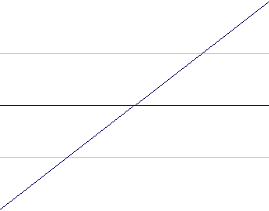
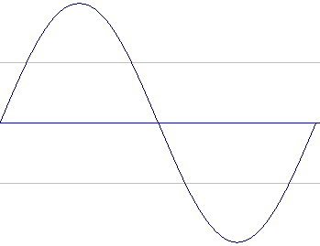
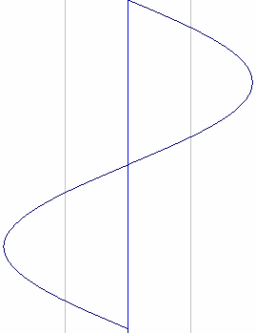
Waveshaping
Output
0.0
0.5
1.0
Index (adress)
amp
1.0
Shape
table
t
0.0
-1.0
(x*0.5)+0.5
The amplitude of the input …
…is used as the index (adress) for table lookup…
…to generate the new waveform.
If the shape table contains a straight line from -1 to 1, the output is identical to the input
Source
t
-1.0
0.0
1.0
amp

Slide 6
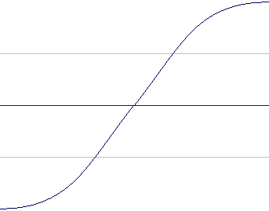
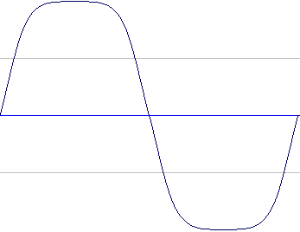
Waveshaping
Output
0.0
0.5
1.0
Index (adress)
amp
1.0
t
0.0
-1.0
In this case we get soft clipping
The change in waveform gives harmonic distortion with odd harmonics (1,3,5,7,9…)
t
-1.0
0.0
1.0
amp

Slide 7
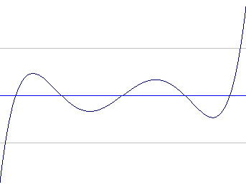
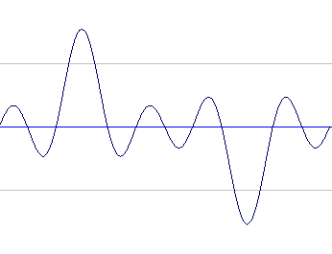
Waveshaping
Output
0.0
0.5
1.0
Index (adress)
amp
1.0
t
0.0
-1.0
GEN 13:
Controlled overtone patterns
Can avoid aliasing
The change in waveform give harmonic distortion
In this example we get even harmonics (2,4,6)
t
-1.0
0.0
1.0
amp

Slide 8
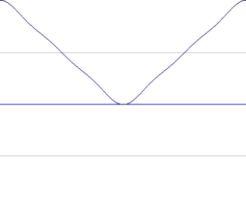
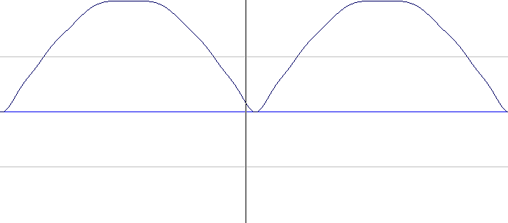
Waveshaping ”Soft” Rectifier
Output
0.0
0.5
1.0
Index (adress)
amp
1.0
t
0.0
-1.0
A softer version of abs(x)
Simple approximation of an analogue rectifier with filtering. Less aliasing.
t
-1.0
0.0
1.0
amp

Slide 9
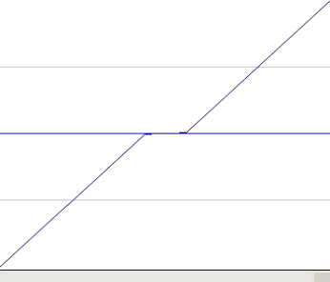
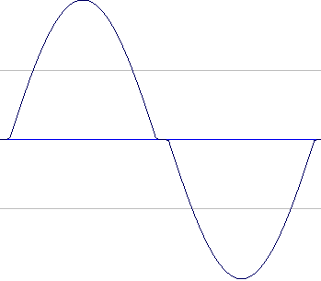
Waveshaping Crossover Distortion
Output
0.0
0.5
1.0
Index (adres)
amp
1.0
t
0.0
-1.0
An error that can occur in a transistor amplifier
Separate circuits used to amplify the positive and negative part of the signal
Distortion/glitch during switch from one circuit to the other
This means: distortion when close to zero but clean elsewhere
t
-1.0
0.0
1.0
amp

Slide 10
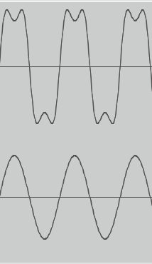
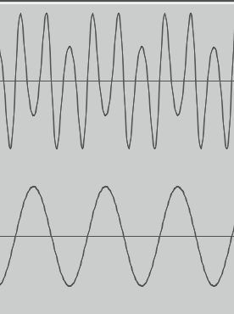
Sin(x) wave-wrapping
Amplitude of input used as phase argument for sin() function

Slide 11
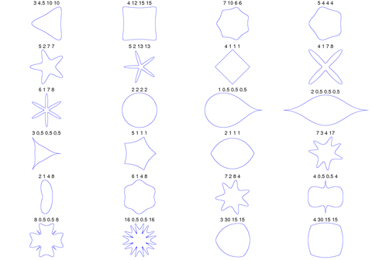
Superformula distortion and other mathematical oddities
https://en.wikipedia.org/wiki/Superformula
In the csd examples for this class, it is named superform_shape_2.csd
Origin: Own experiments (Brandtsegg 2020-2021), inspired by
Christian Bacher experiments with same formula for WaveTerrain synthesis
https://www.docb.io/superterrain/
See also: https://www.youtube.com/watch?v=u6arTXBDYhQ&t=272s&ab_channel=AlexanderMiller

Slide 12
Intermodulation
With complex waveforms, f.ex. polyphonic signal, we will get intermodulation in distortion
This leads to sidebands with sum and difference frequencies. Can be hard to control/predict. But is nice also.
To lessen this effect, we can use multiband distortion (frequency split signal, and do separate distortion on each band)
In synthesizers we can optionally do separate distortion per note/oscillator

Slide 13
Filtering and distortion
Distortion adds new harmonics
Pre dist filter might help avoid aliasing
Post dist filter might be useful to round off the sound
In Csound:
butterlp: "standard" gentle lowpass
lpf18: 18dB/oct lowpass with dist and resonance
Many more (!): moogladder, svfilter, spf, skf, …

Slide 14
Summing up
Clip, Wrap, Mirror
tanh(), modified tanh()
Waveshaping
Abuse of mathematical formulas

