Slide 1
Bitreduction Make a VST plugin Downsampling Panning
Ear training for digital audio production
Øyvind Brandtsegg

Slide 2
Digitizing (Sampling)
Analog sound wave
0,09983342
0,19866933
0,29552021
0,38941834
0,47942554
0,56464247
0,64421769 …
Digital sound, fine resolution
0,5
0,8
1
0,9
0,6
0,1
-0,4
Digital sound, coarse resolution

Slide 3
Bit reduction
b = bits, n = steps (discrete values)
n=2^{(b)}
16 bits audio has 65536 steps
Range = -32768 to +32767
Bitreduction algorithm (we want balanced +/-)
n=2^{(b-1)} gives number of bipolar steps a=round(a*n)/n
Gives normalized output
Allows ”fractional” bits (nonsensical but useful)

Slide 4
VST plugin from DSP kode
Cabbage: open csd, export as effect
Save in folder where your DAW expect to find plugins
Windows: same name (.csd og .dll)
OSX: .vst file is a bundle (.csd is inside bundle)
Enable ad hoc codesign in Settings/Miscellaneous
<Cabbage>
form size(400, 300), caption("MyCoolPlug"), pluginId("new1")
rslider channel("Volume"), bounds(10, 25, 70, 70),
text("Volume"), range(0, 1, 1, 0.35)
rslider channel("Drive"), bounds(90, 25, 70, 70),
text("Drive"), range(1, 10, 1)
</Cabbage>
<CsOptions>
-n -d
</CsOptions>

Slide 5
Resampling Upsampling – interpolation - decimation/downsampling
Nyquist, Aliasing, Mirror images
Simplified algorithm: (Downsampling/Decimation)
Pulse generator at new sample rate
Sample and hold
Generous amount of artifacts/aliasing
”zero-order hold distortion”
Linear interpolation
Disregard in-between samples
Line segment between each sample
Zero padding
In-between samples = null
Lowpass filter
NB: As a processing effect, we downsample but represent the signal in the original sampling rate. This works differently than «real» downsampling.
http://dspguru.com/dsp/faqs/multirate/resampling

Slide 6
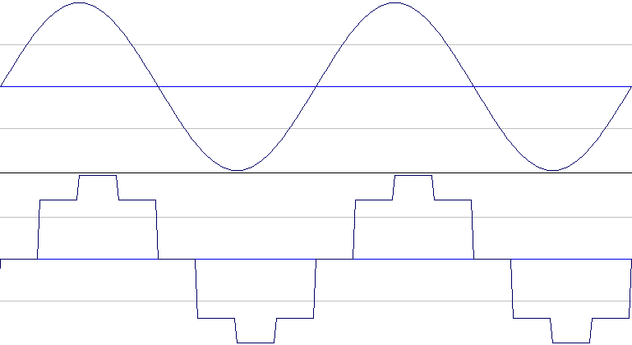
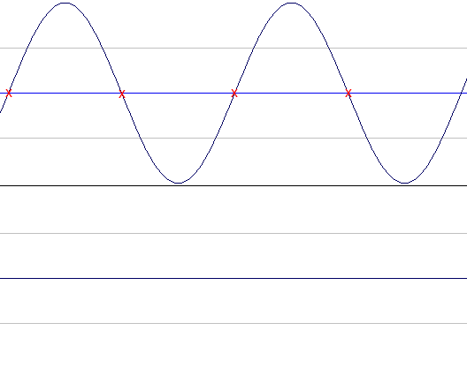
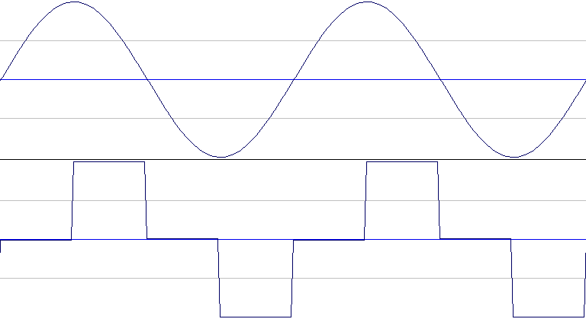
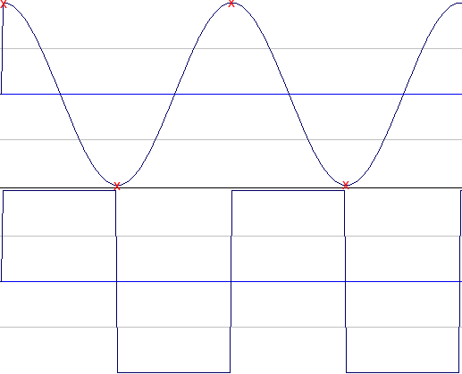
Samplerate, Nyquist ?
sr/8
sr/2
sr/4
sr/2

Slide 7
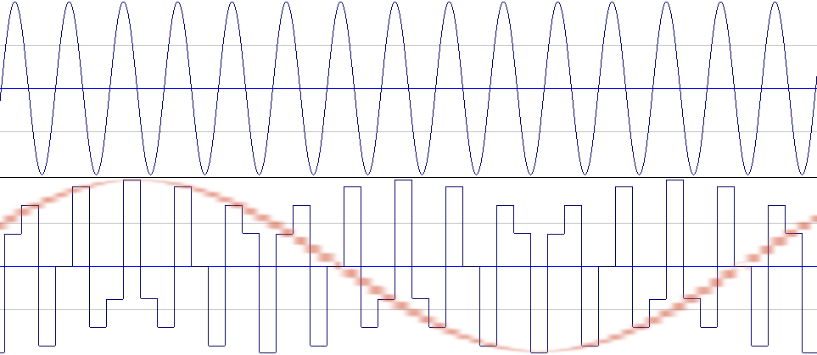
Aliasing
Zero order hold distortion

Slide 8
In practice
When should we be especially aware and cautious about aliasing?
…When processing the audio signal in such a way that we might generate new frequencies, e.g. distortion, modulation, etc.

Slide 9
Workshop assignment
Explore code examples for bitreduction and resampling
Run offline (terminal: csound bitreduction.csd)
Make VST/AU plugin
Run in Cabbage
Export plugin
Run in DAW

