Slide 1
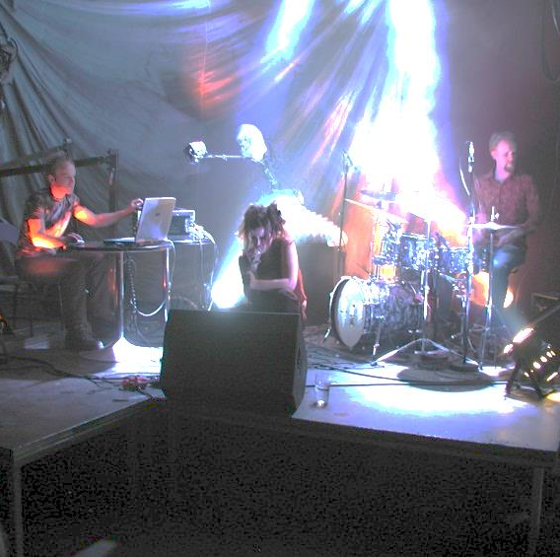
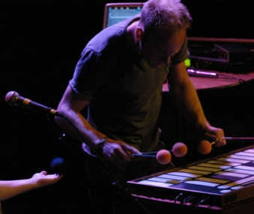
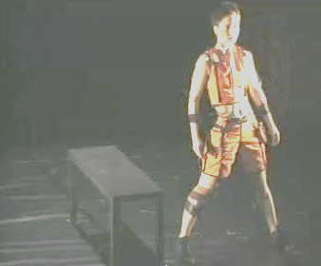
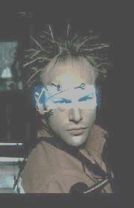
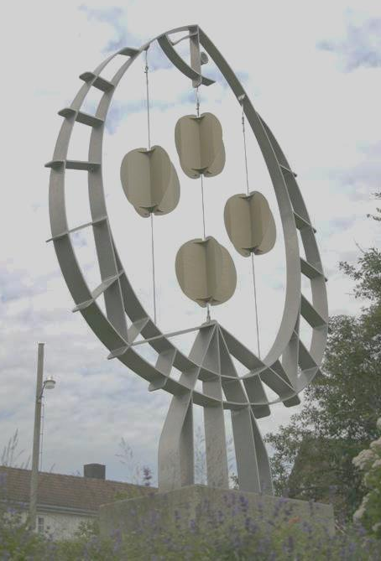
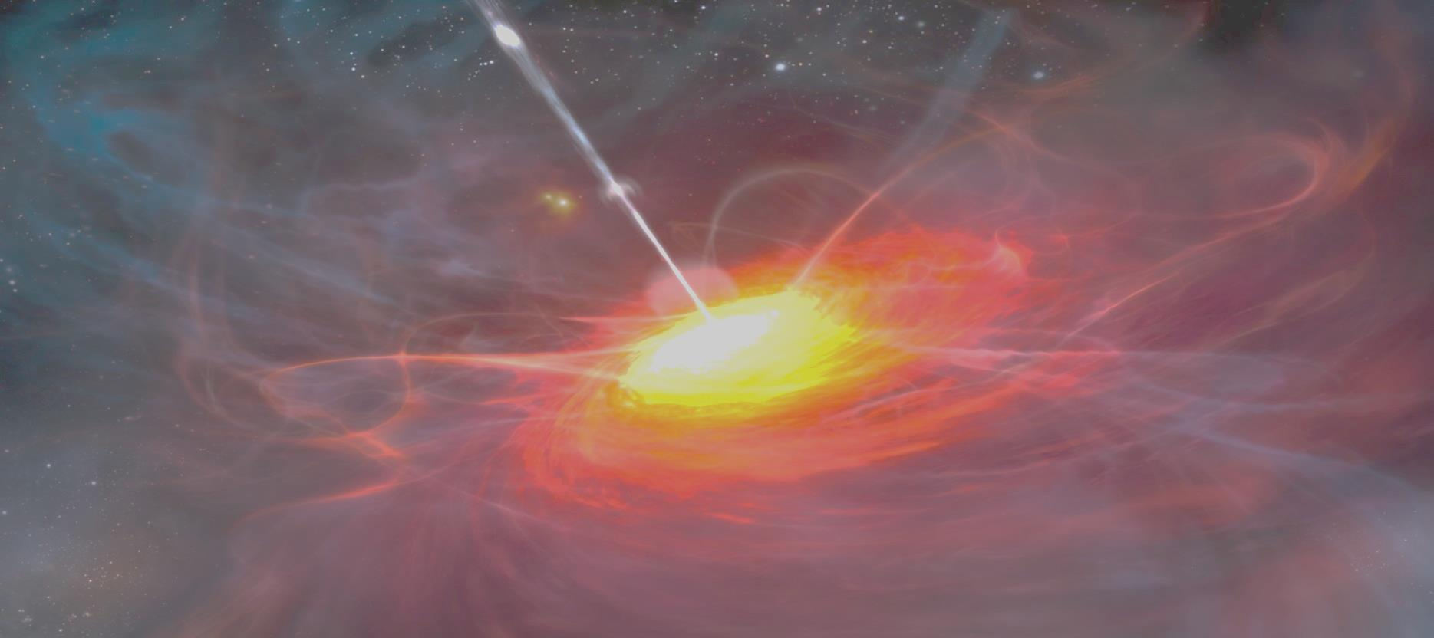
Playful new instruments
New applications of old technology
Sound art installations as instruments
Large instruments: Bridges
Environmental issues, recycling
Feedback
DSP ear training

Slide 2
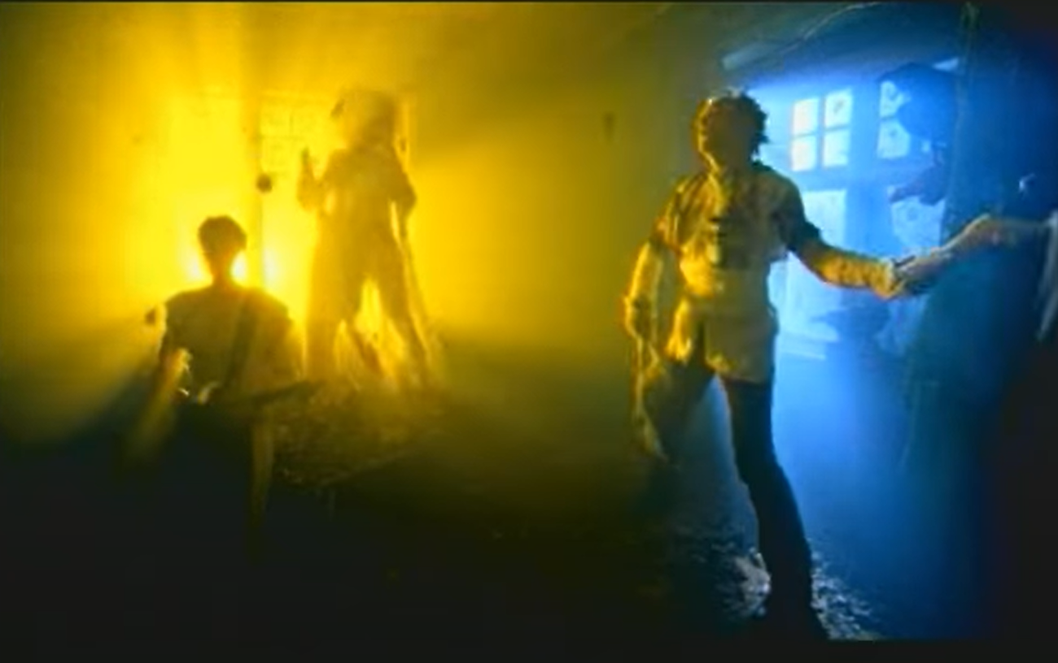
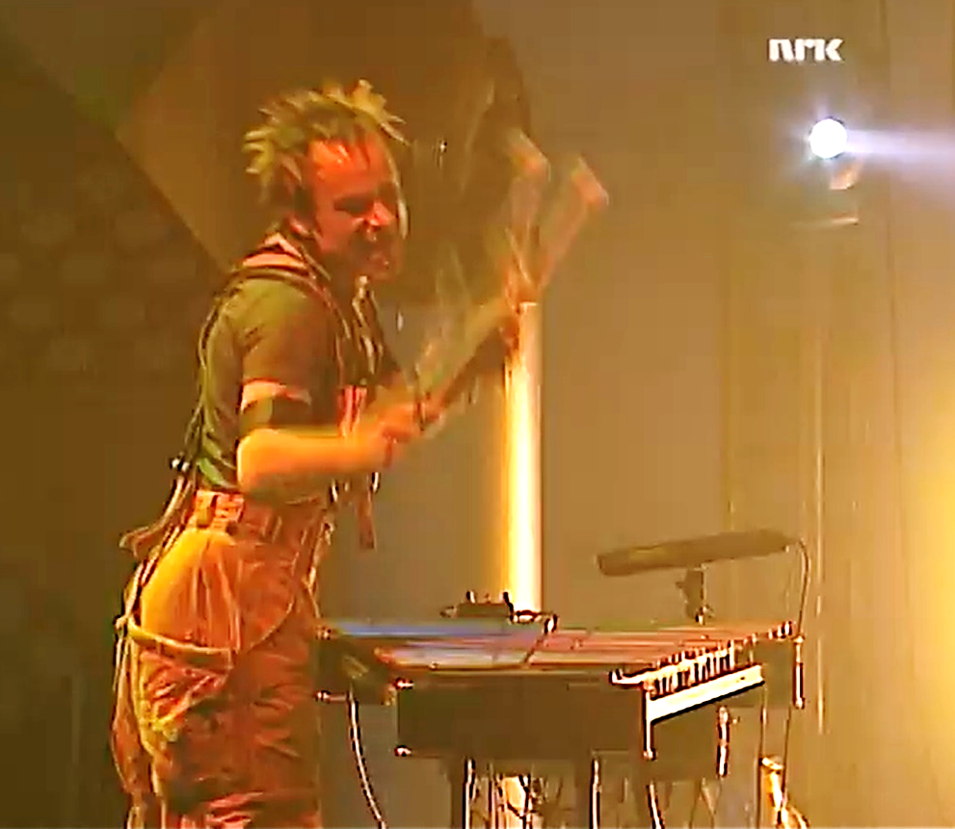
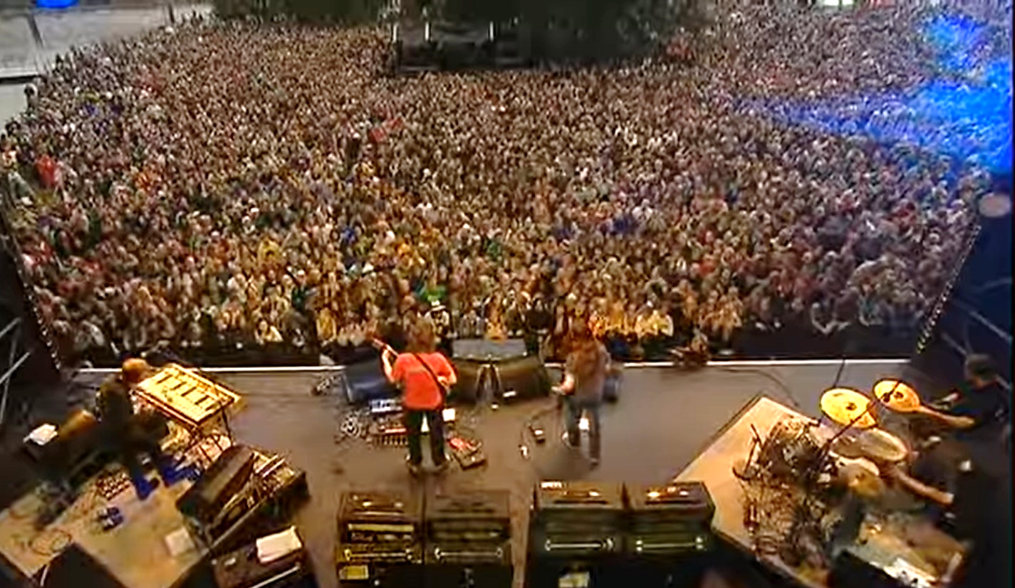
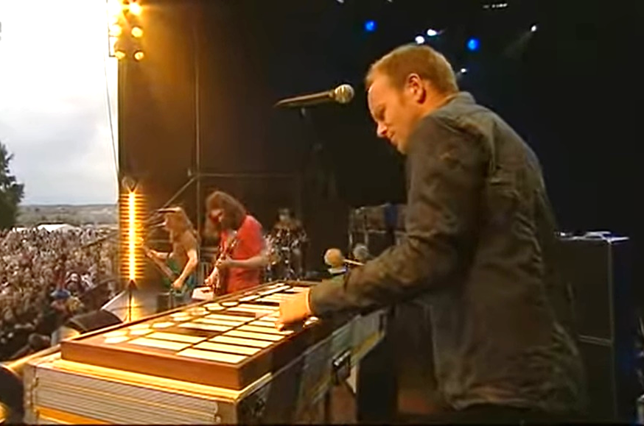

Slide 3
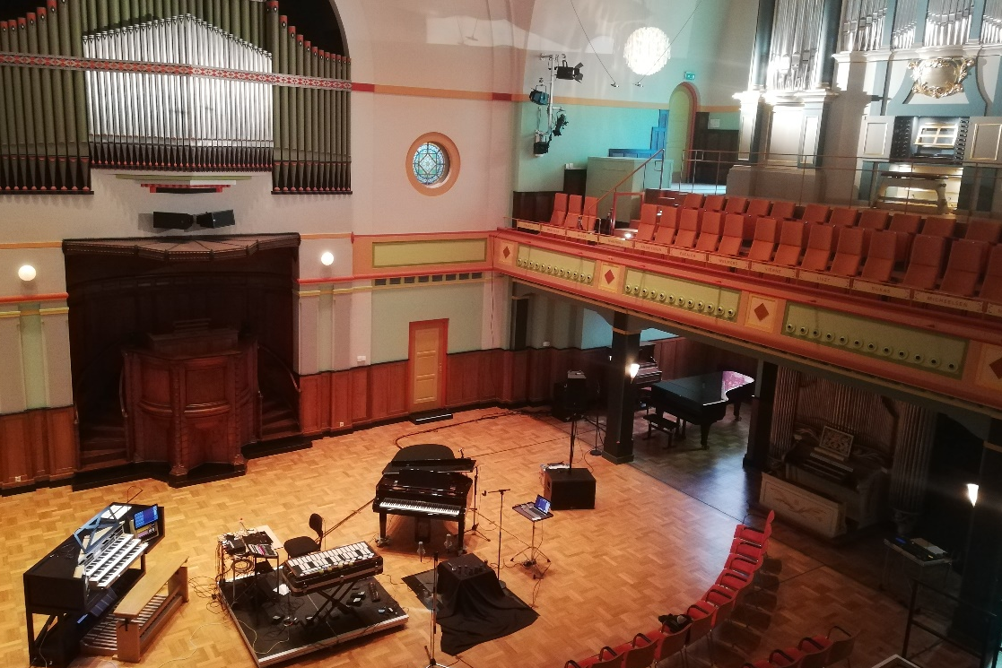
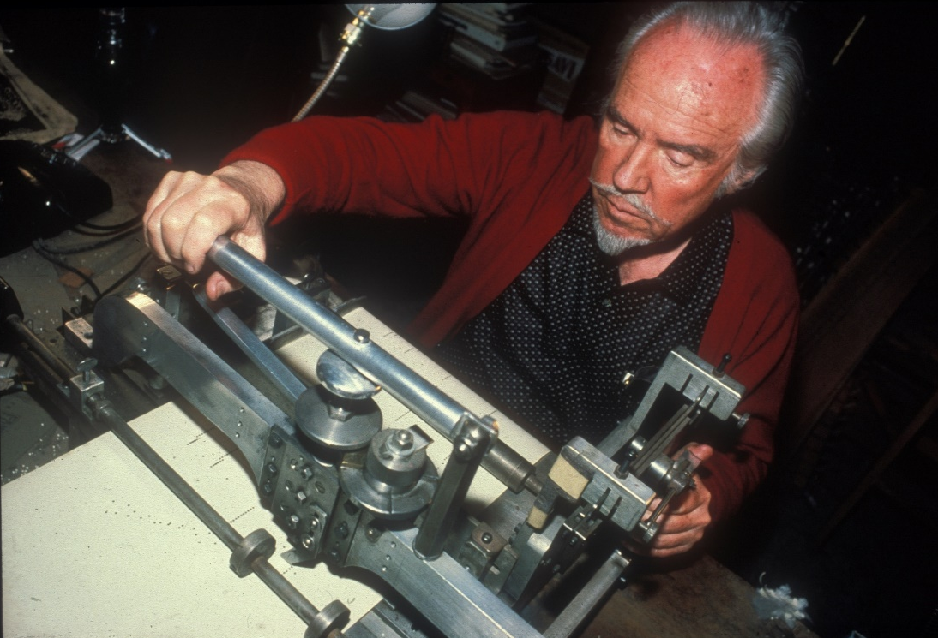
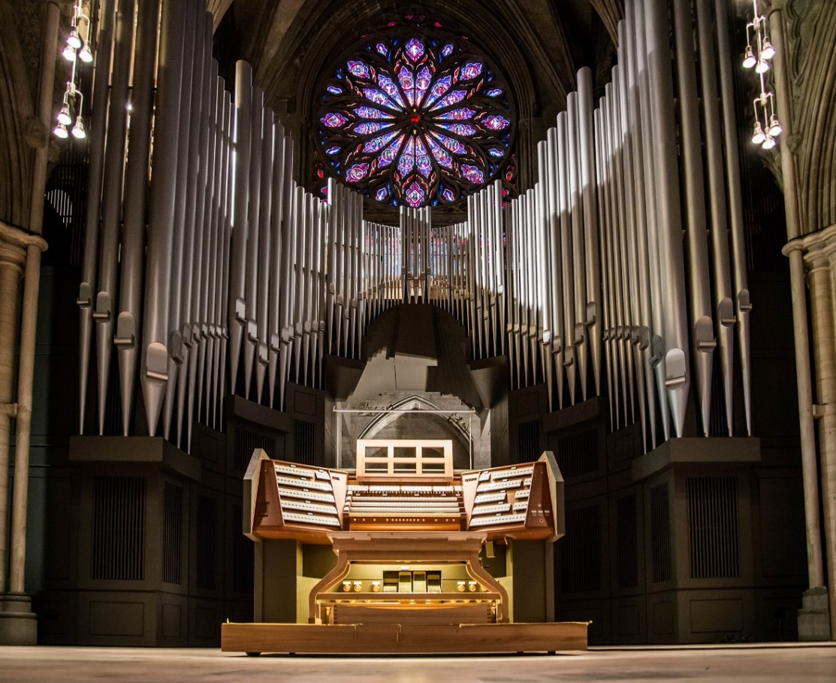
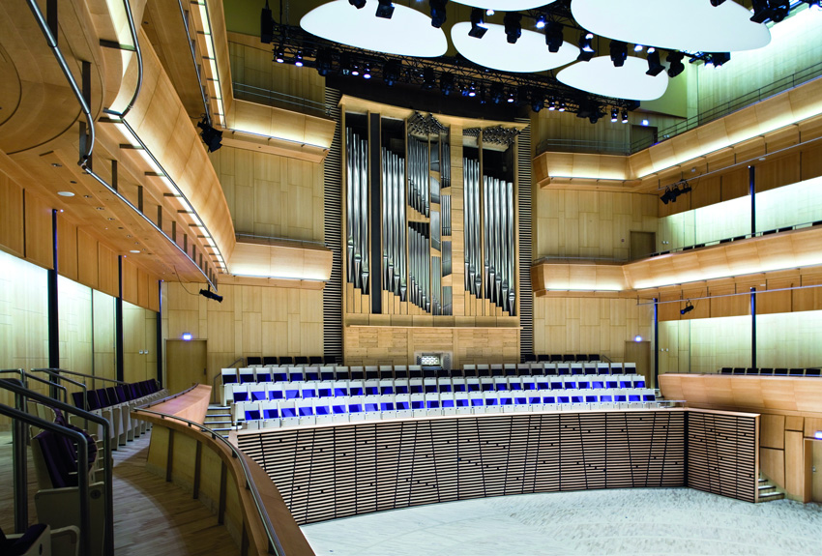
New applications, old technology
https://vimeo.com/463046453

Slide 4
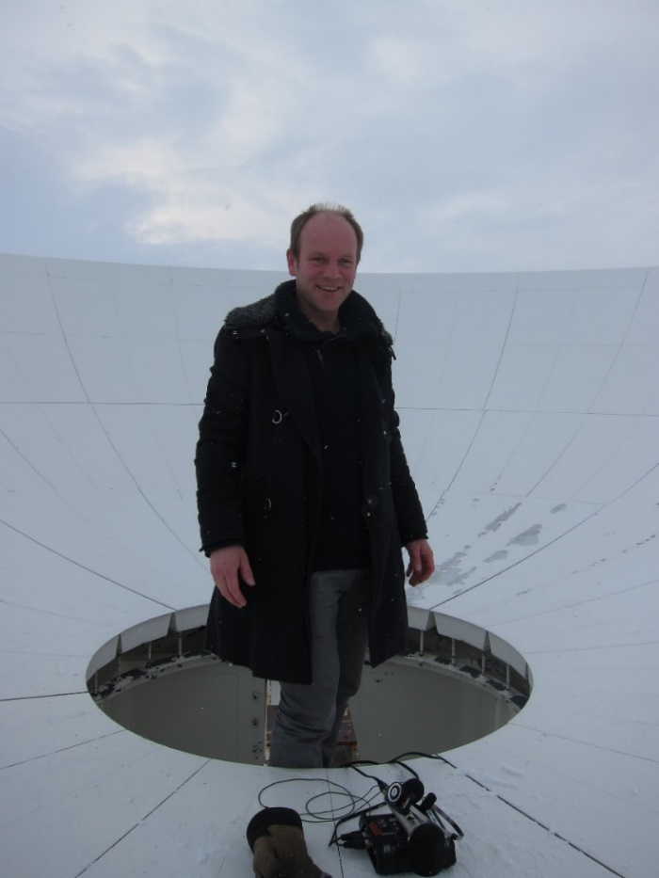
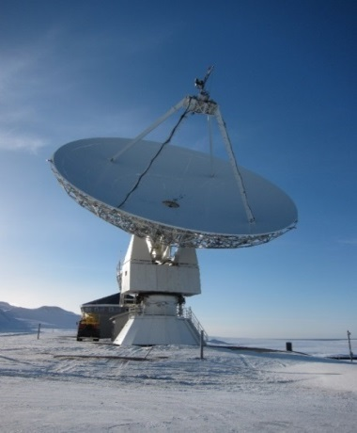
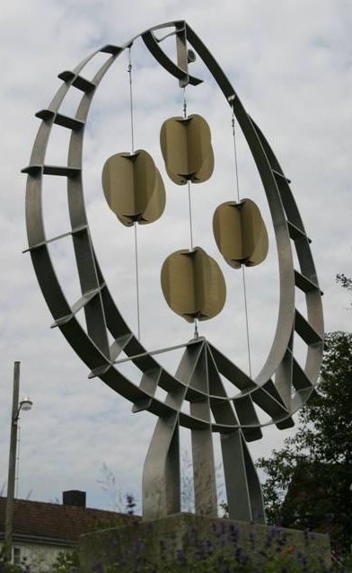
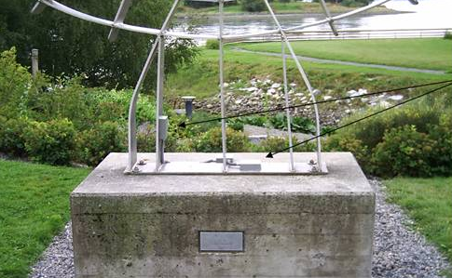
Sound art installations as musical instruments
Notes:
Svalbard, experience the antenna and environment

Slide 5
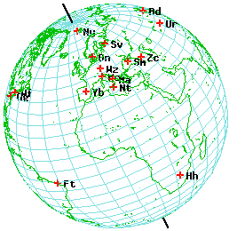
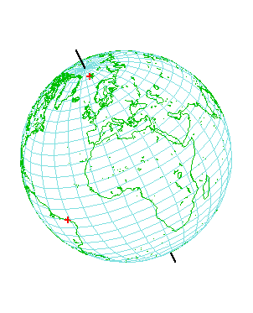
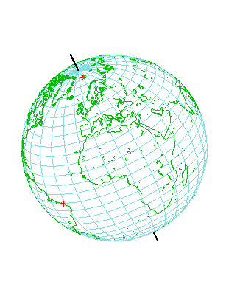
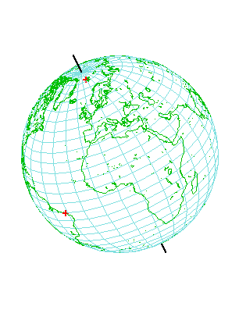
VLBI: Global choreography
Notes:
Global coreography of the antennas

Slide 6
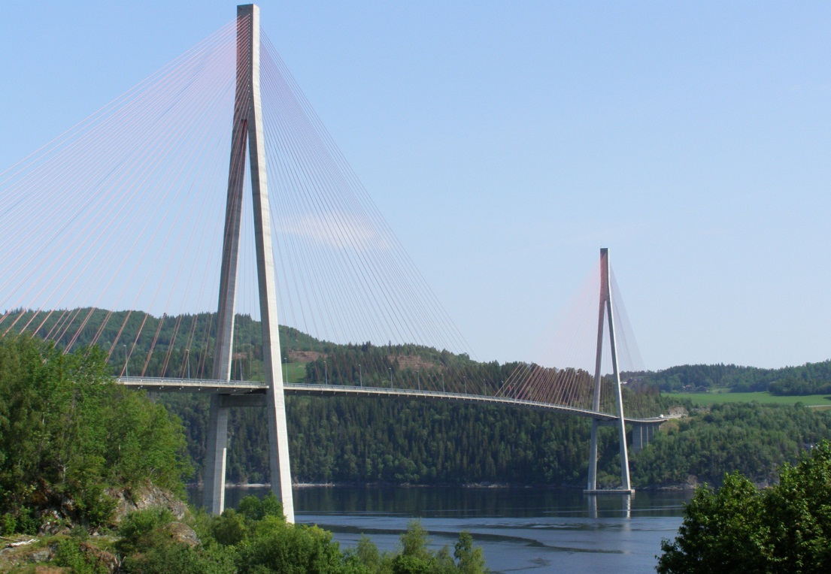
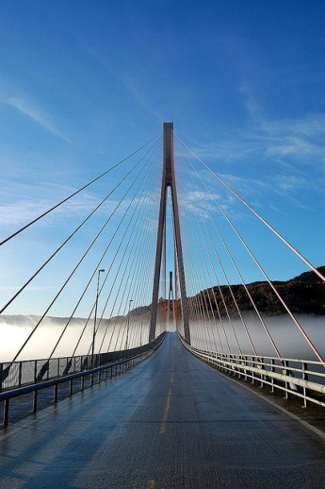
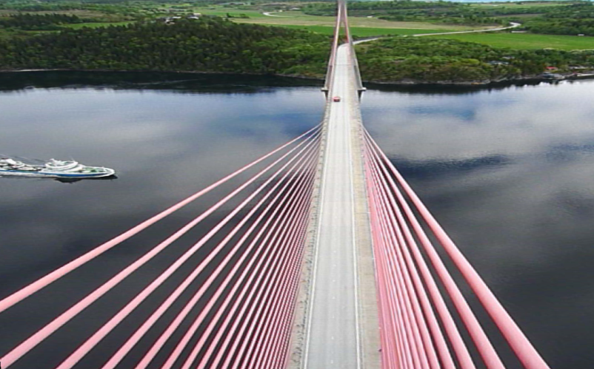
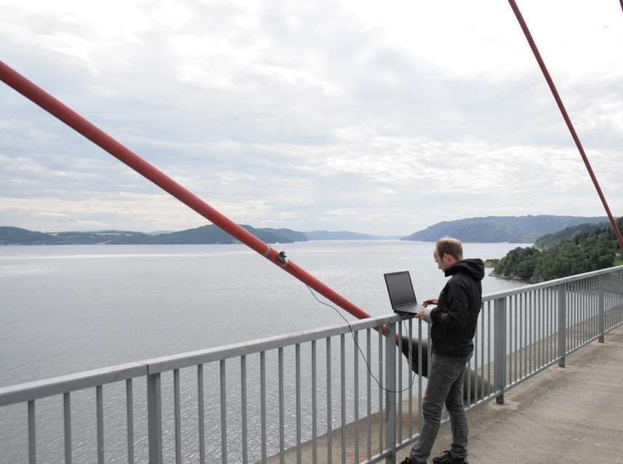
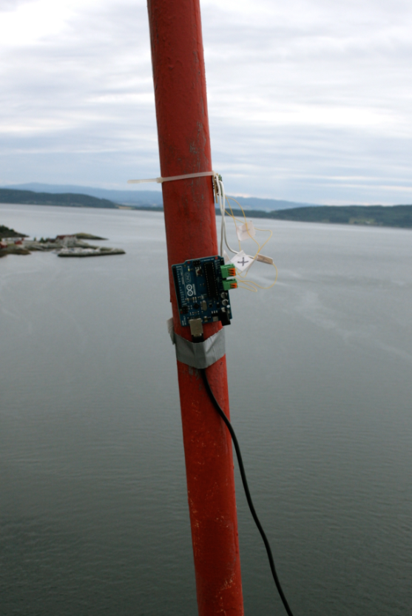
Skarnsundbrua

Slide 7
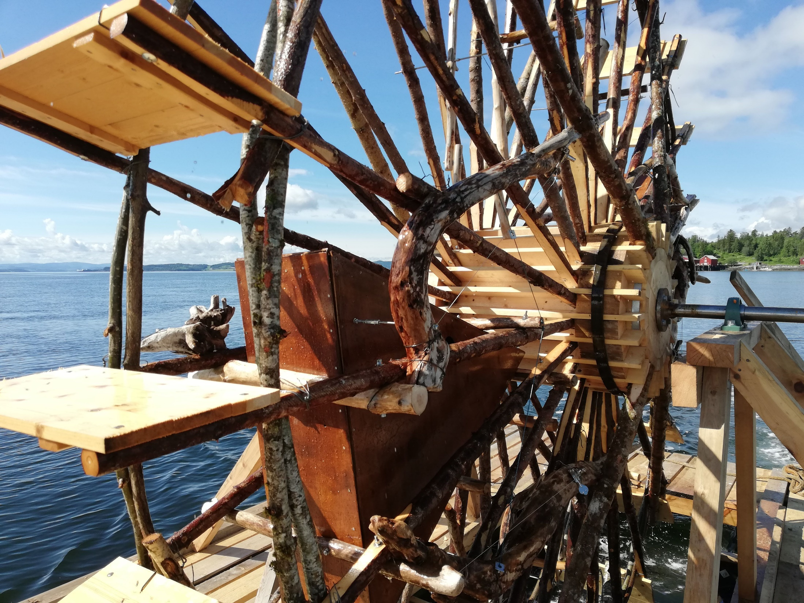
Environment, Recycling, Energy
https://www.youtube.com/watch?v=1gAPn_e_cE0

Slide 8
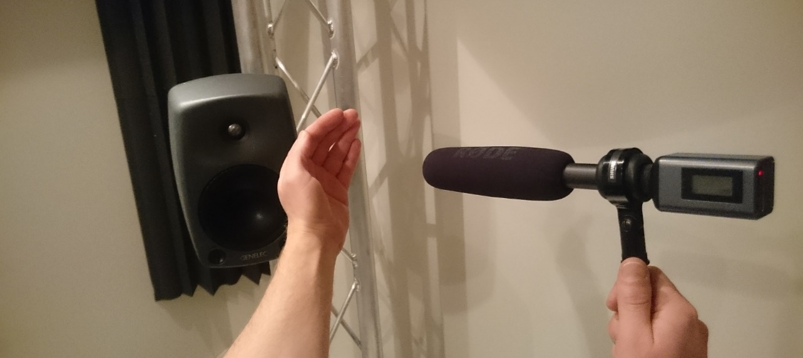
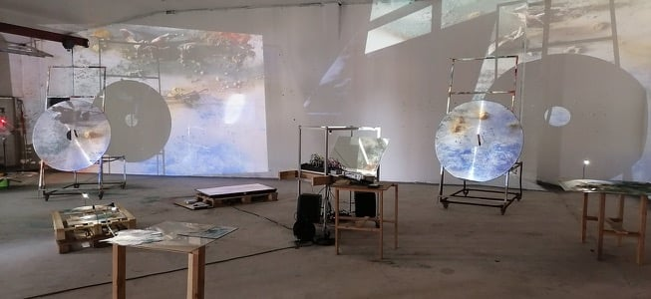
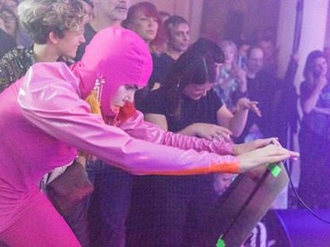
Recycling - Feedback

Slide 9
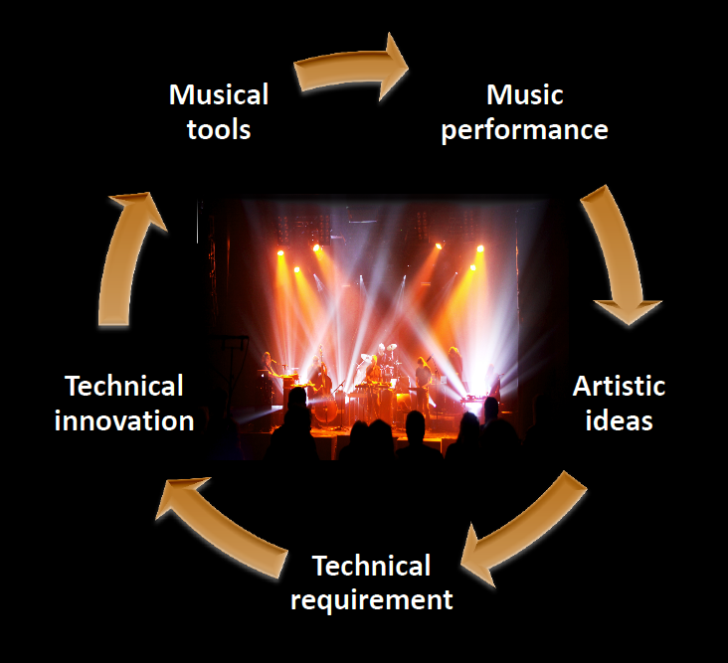
Process, over time

Slide 10
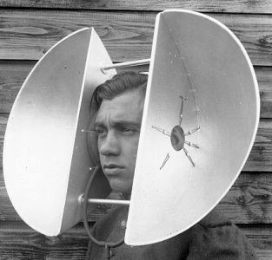
GDSP
Gehør for Digital Signalprosessering
Ear training for digital audio production
Øyvind Brandtsegg

Slide 11
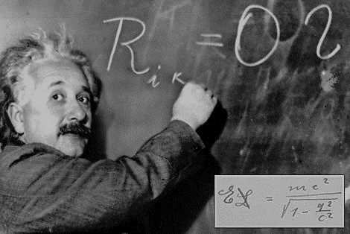
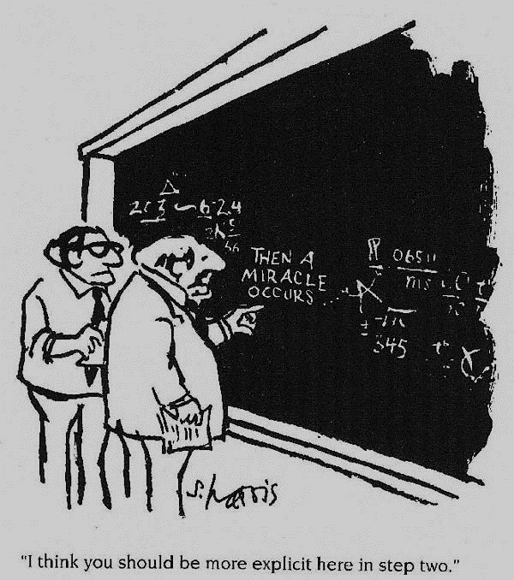
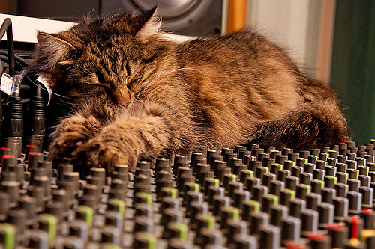
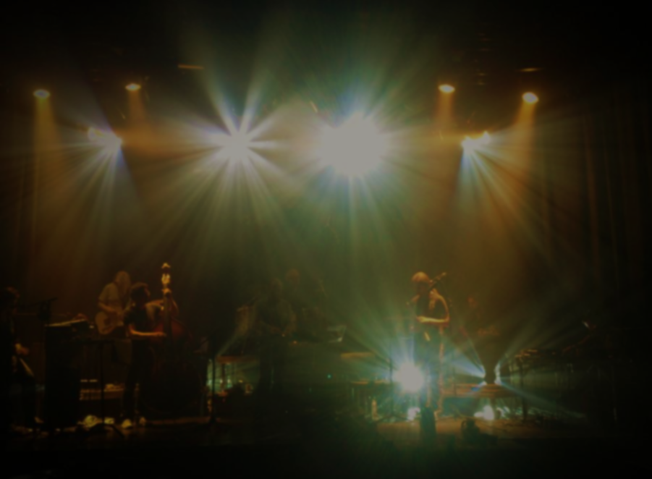

Slide 12
About the workshop
What we focus on
Resources
http://gdsp.hf.ntnu.no/ (made for this course)
http://harmanhowtolisten.blogspot.no/
See also: https://www.soundgym.co/
Curriculum:
Lectures and slides
Additional reading materials

Slide 13
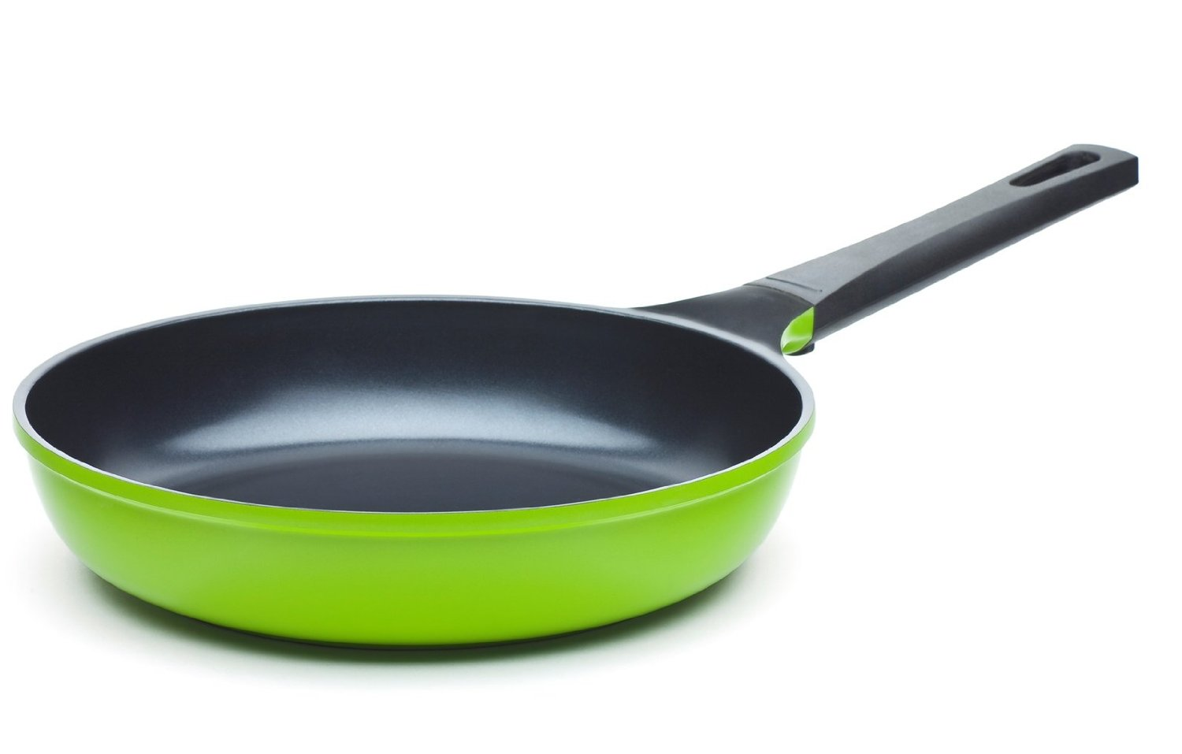
Warm up: Pan

Slide 14
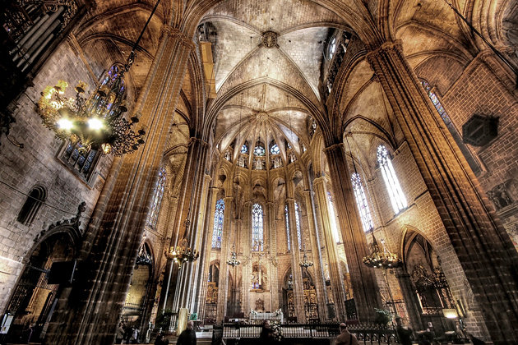
Reverb
Reverb time
Reverb mix

Slide 15
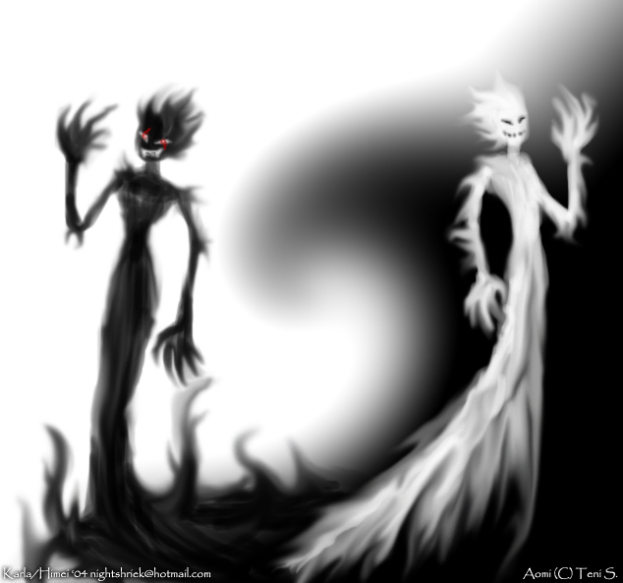
Spectral balance
Bright/Dull

Slide 16
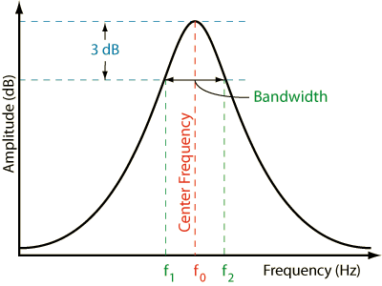
Frequency range, Filter types, Cutoff
Hipass, Lowpass, Bandpass, -reject
Filter bandwidth, Q, oct
https://www.ranecommercial.com/legacy/note170.html

Slide 17
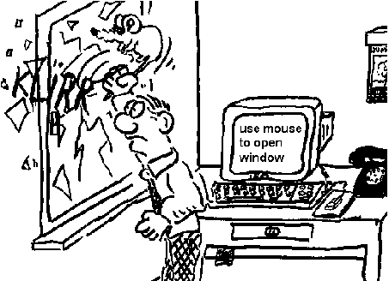
Terminology…
… depends on context

Slide 18
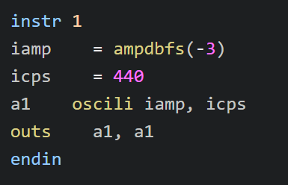
Ear training and coding
Listen
Describe, discuss
Be open and discuss what you do not hear yet!
Do it (sing, play, code)
Reference in sound
Reference to theory, algorithm, maths

Slide 19
